Slide 1
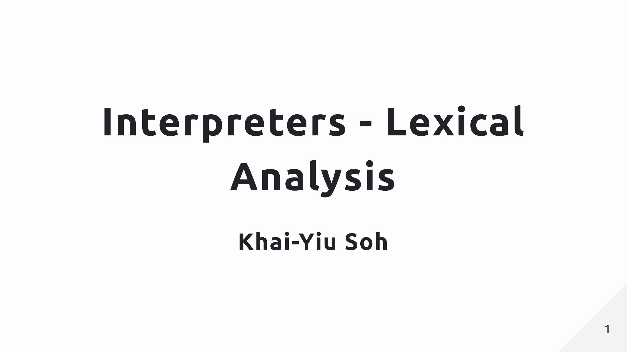

Slide 2
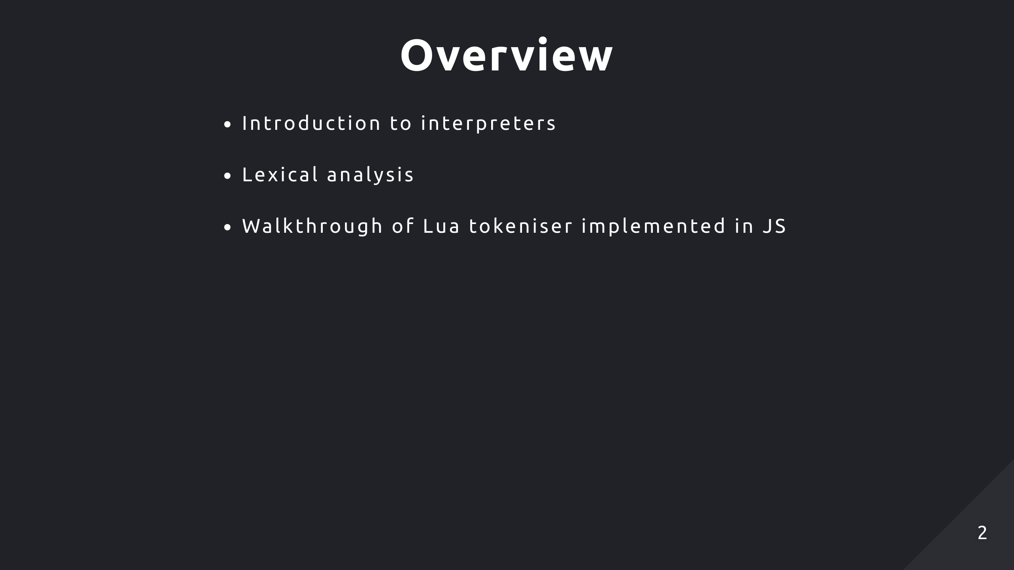

Slide 3
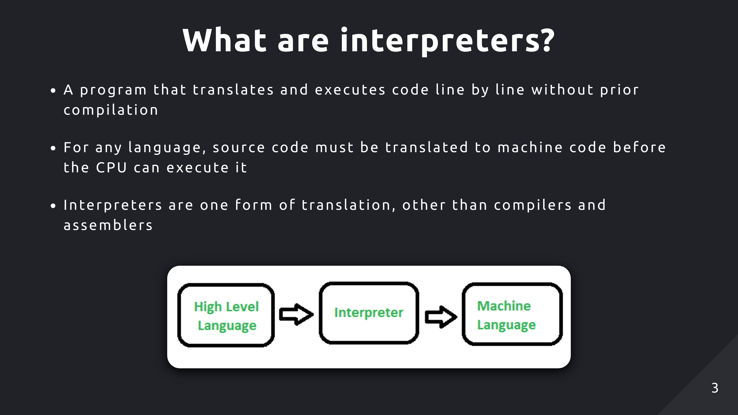

Slide 4
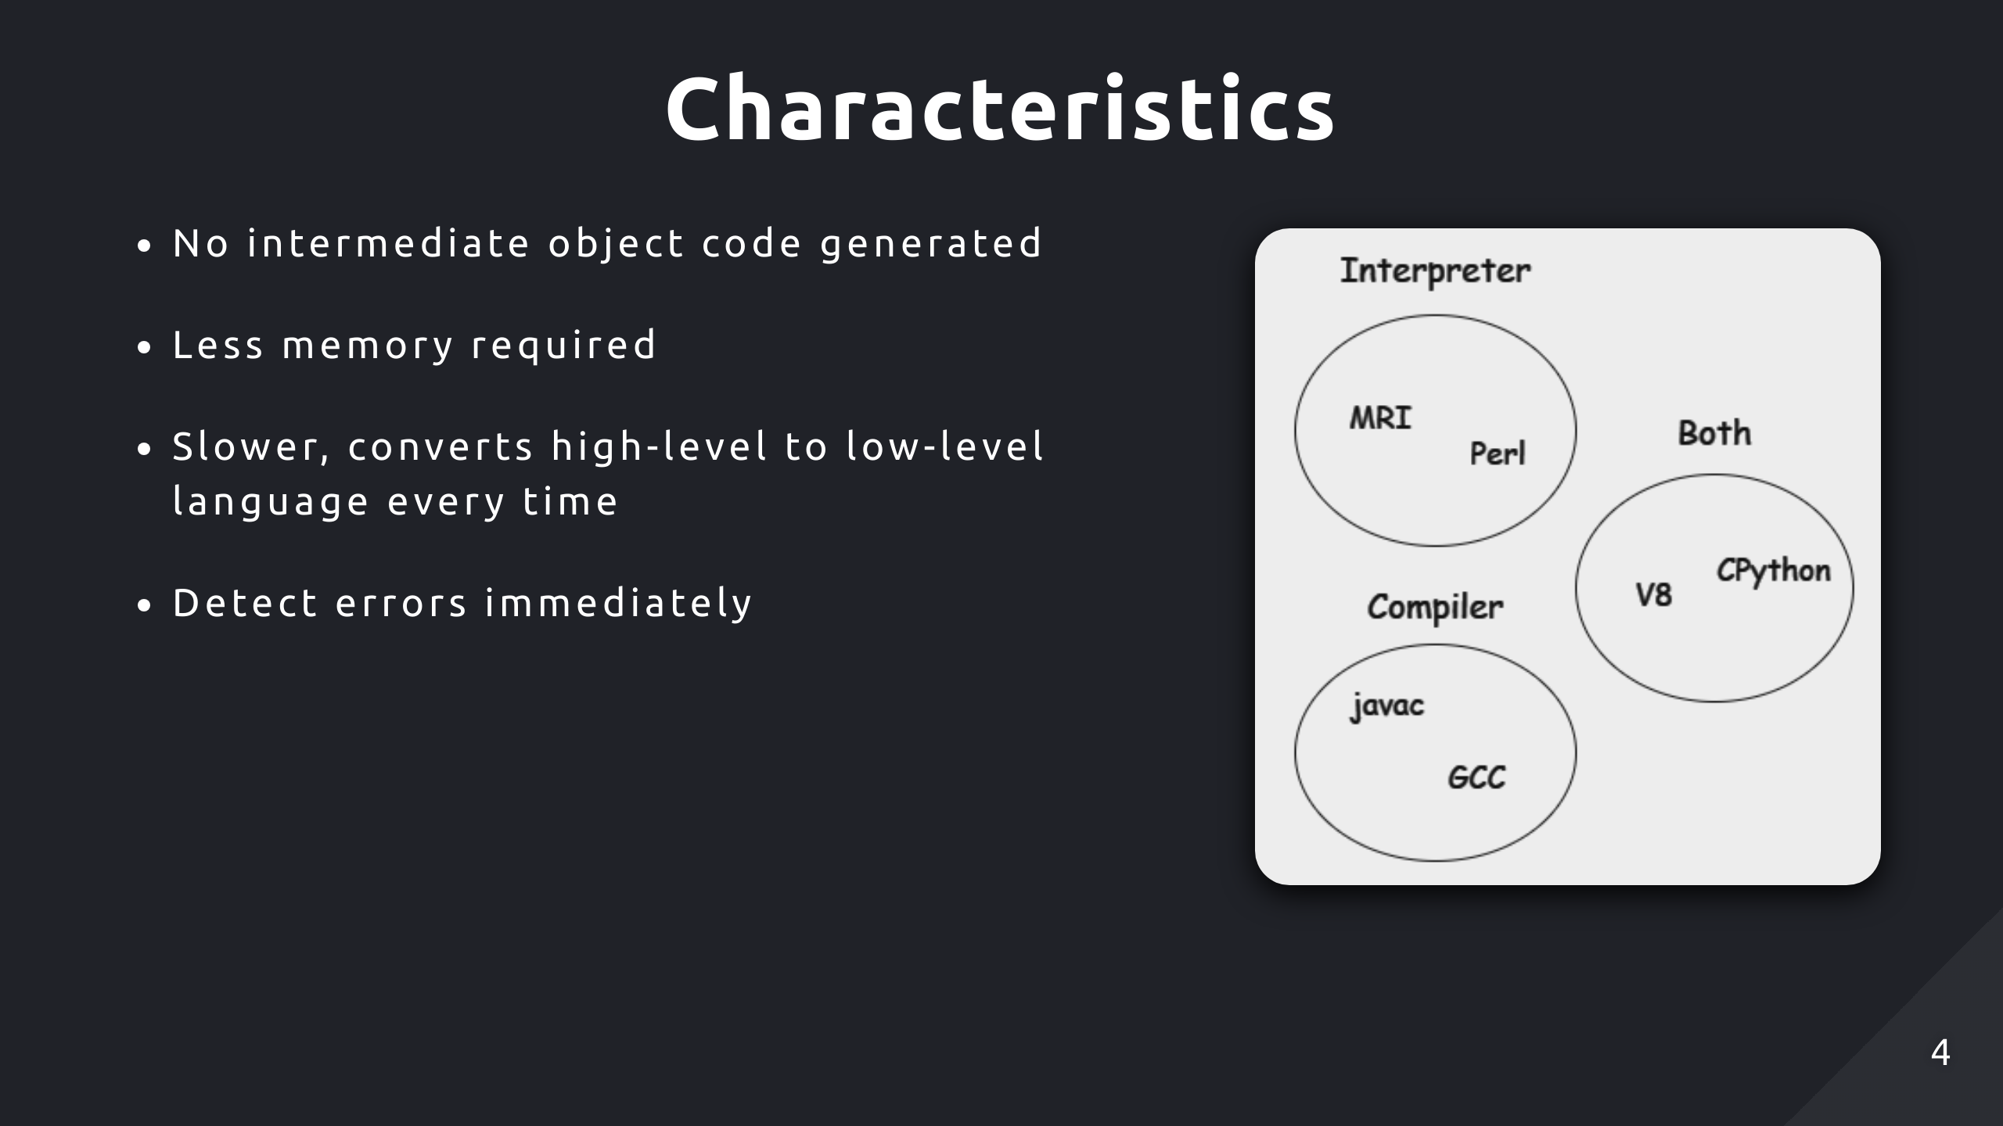
Notes:
Most high level languages use a hybrid approach (just in time compilation)
Compile code into an intermediate representation like bytecode that can be interpreted easier

Slide 5
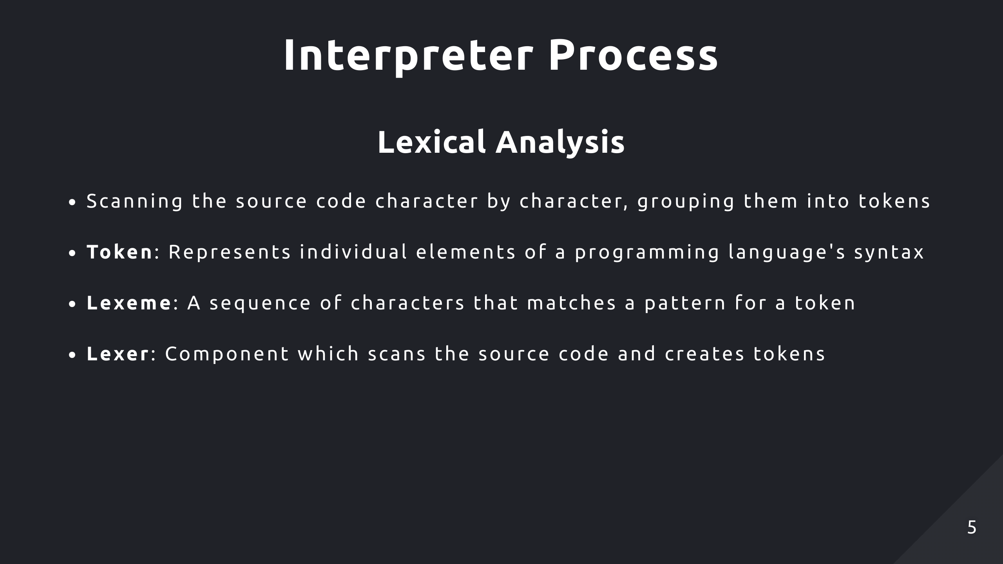
Notes:
Tokens: Variables, keywords, operators, semicolons
Lexeme: Raw source code matching token

Slide 6
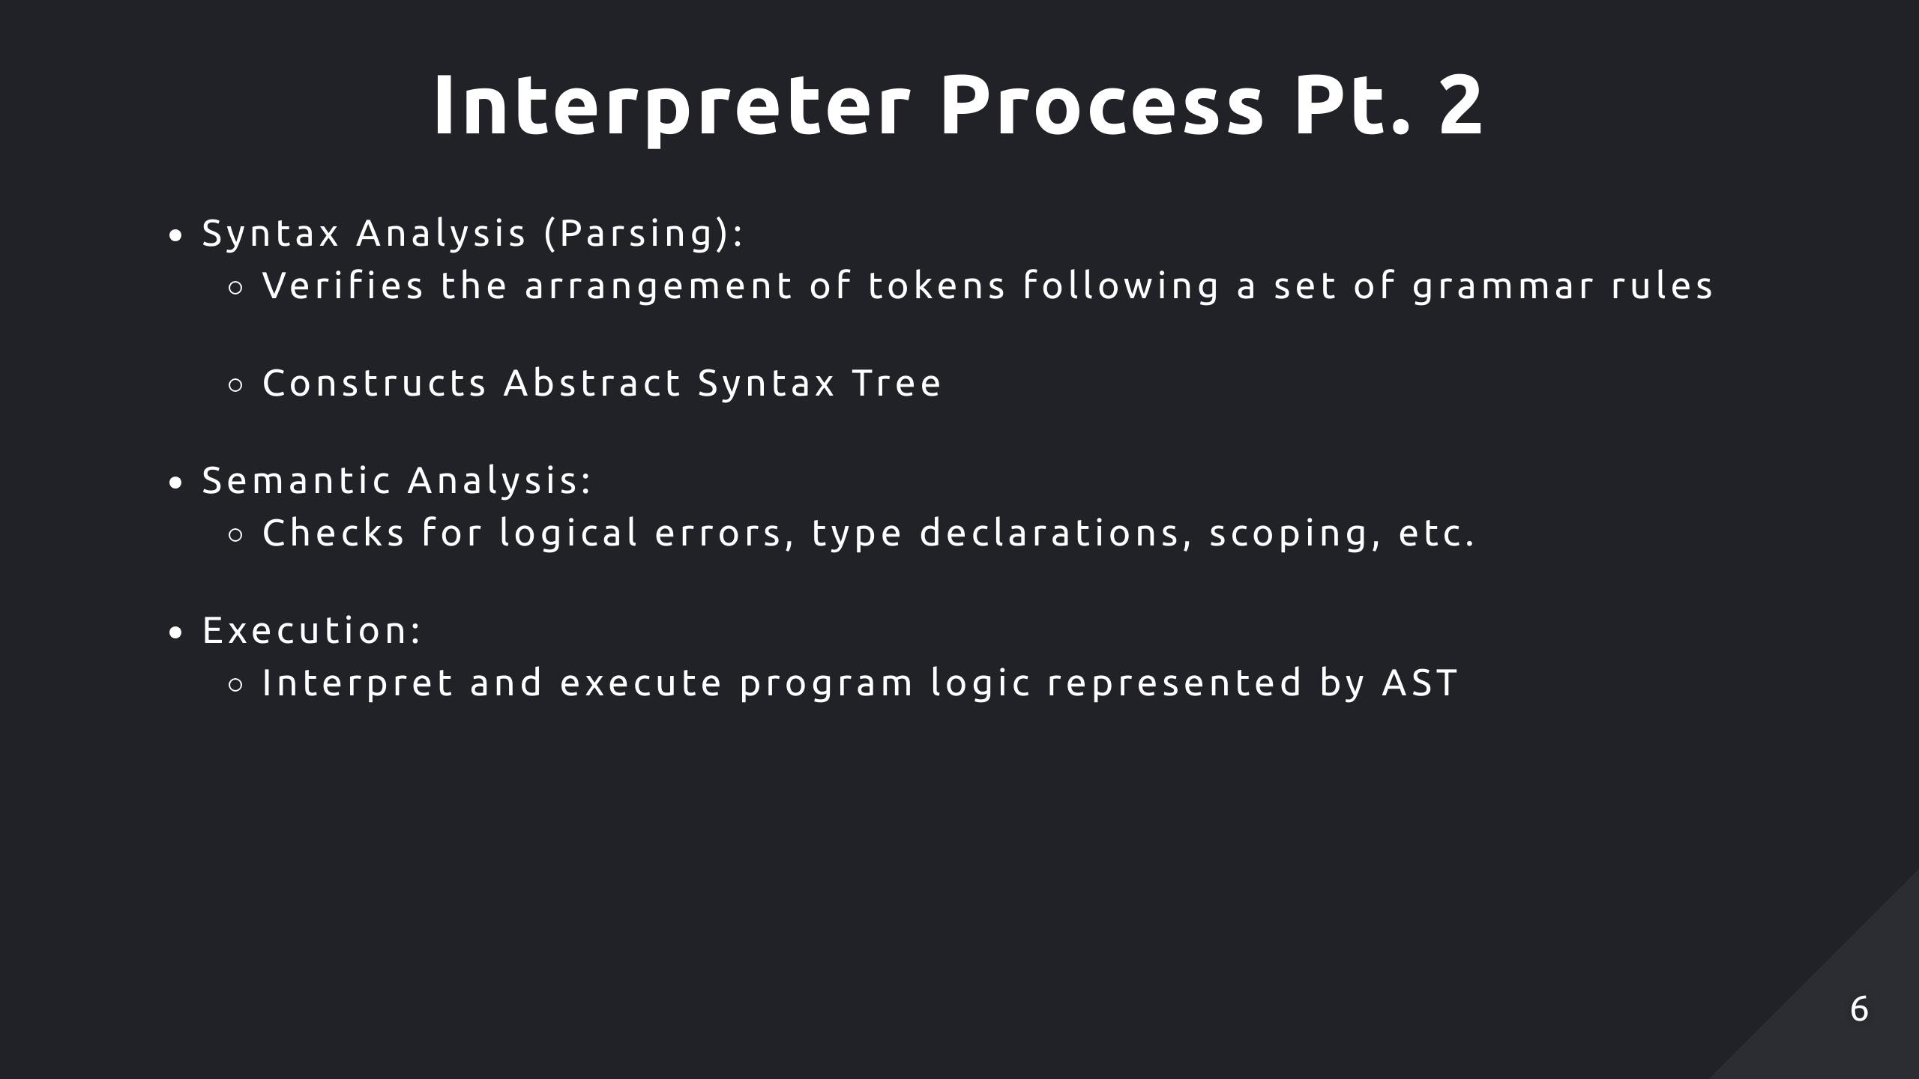
Notes:
Syntax: const/var/let name = value
Possible optimisation/intermediate representation before execution

Slide 7
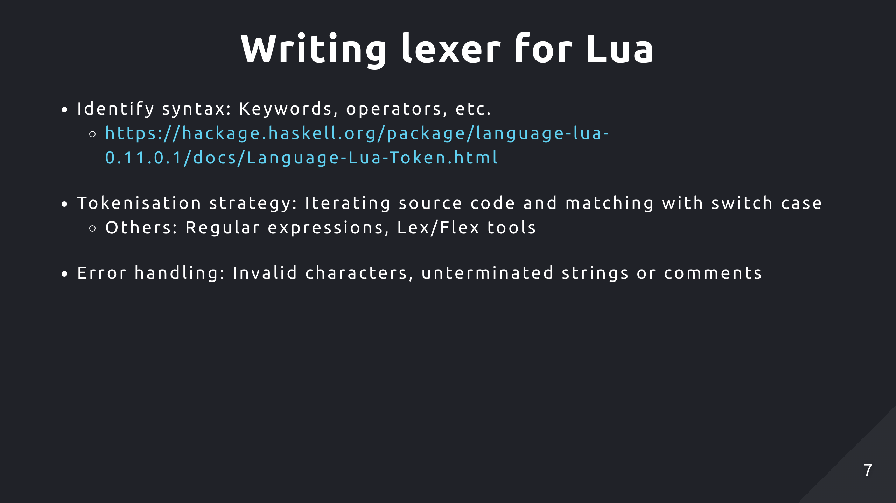
Notes:
Lex/flex generate lexers in C
Declarative tool, you specify a set of rules to define patterns with regex

Slide 8
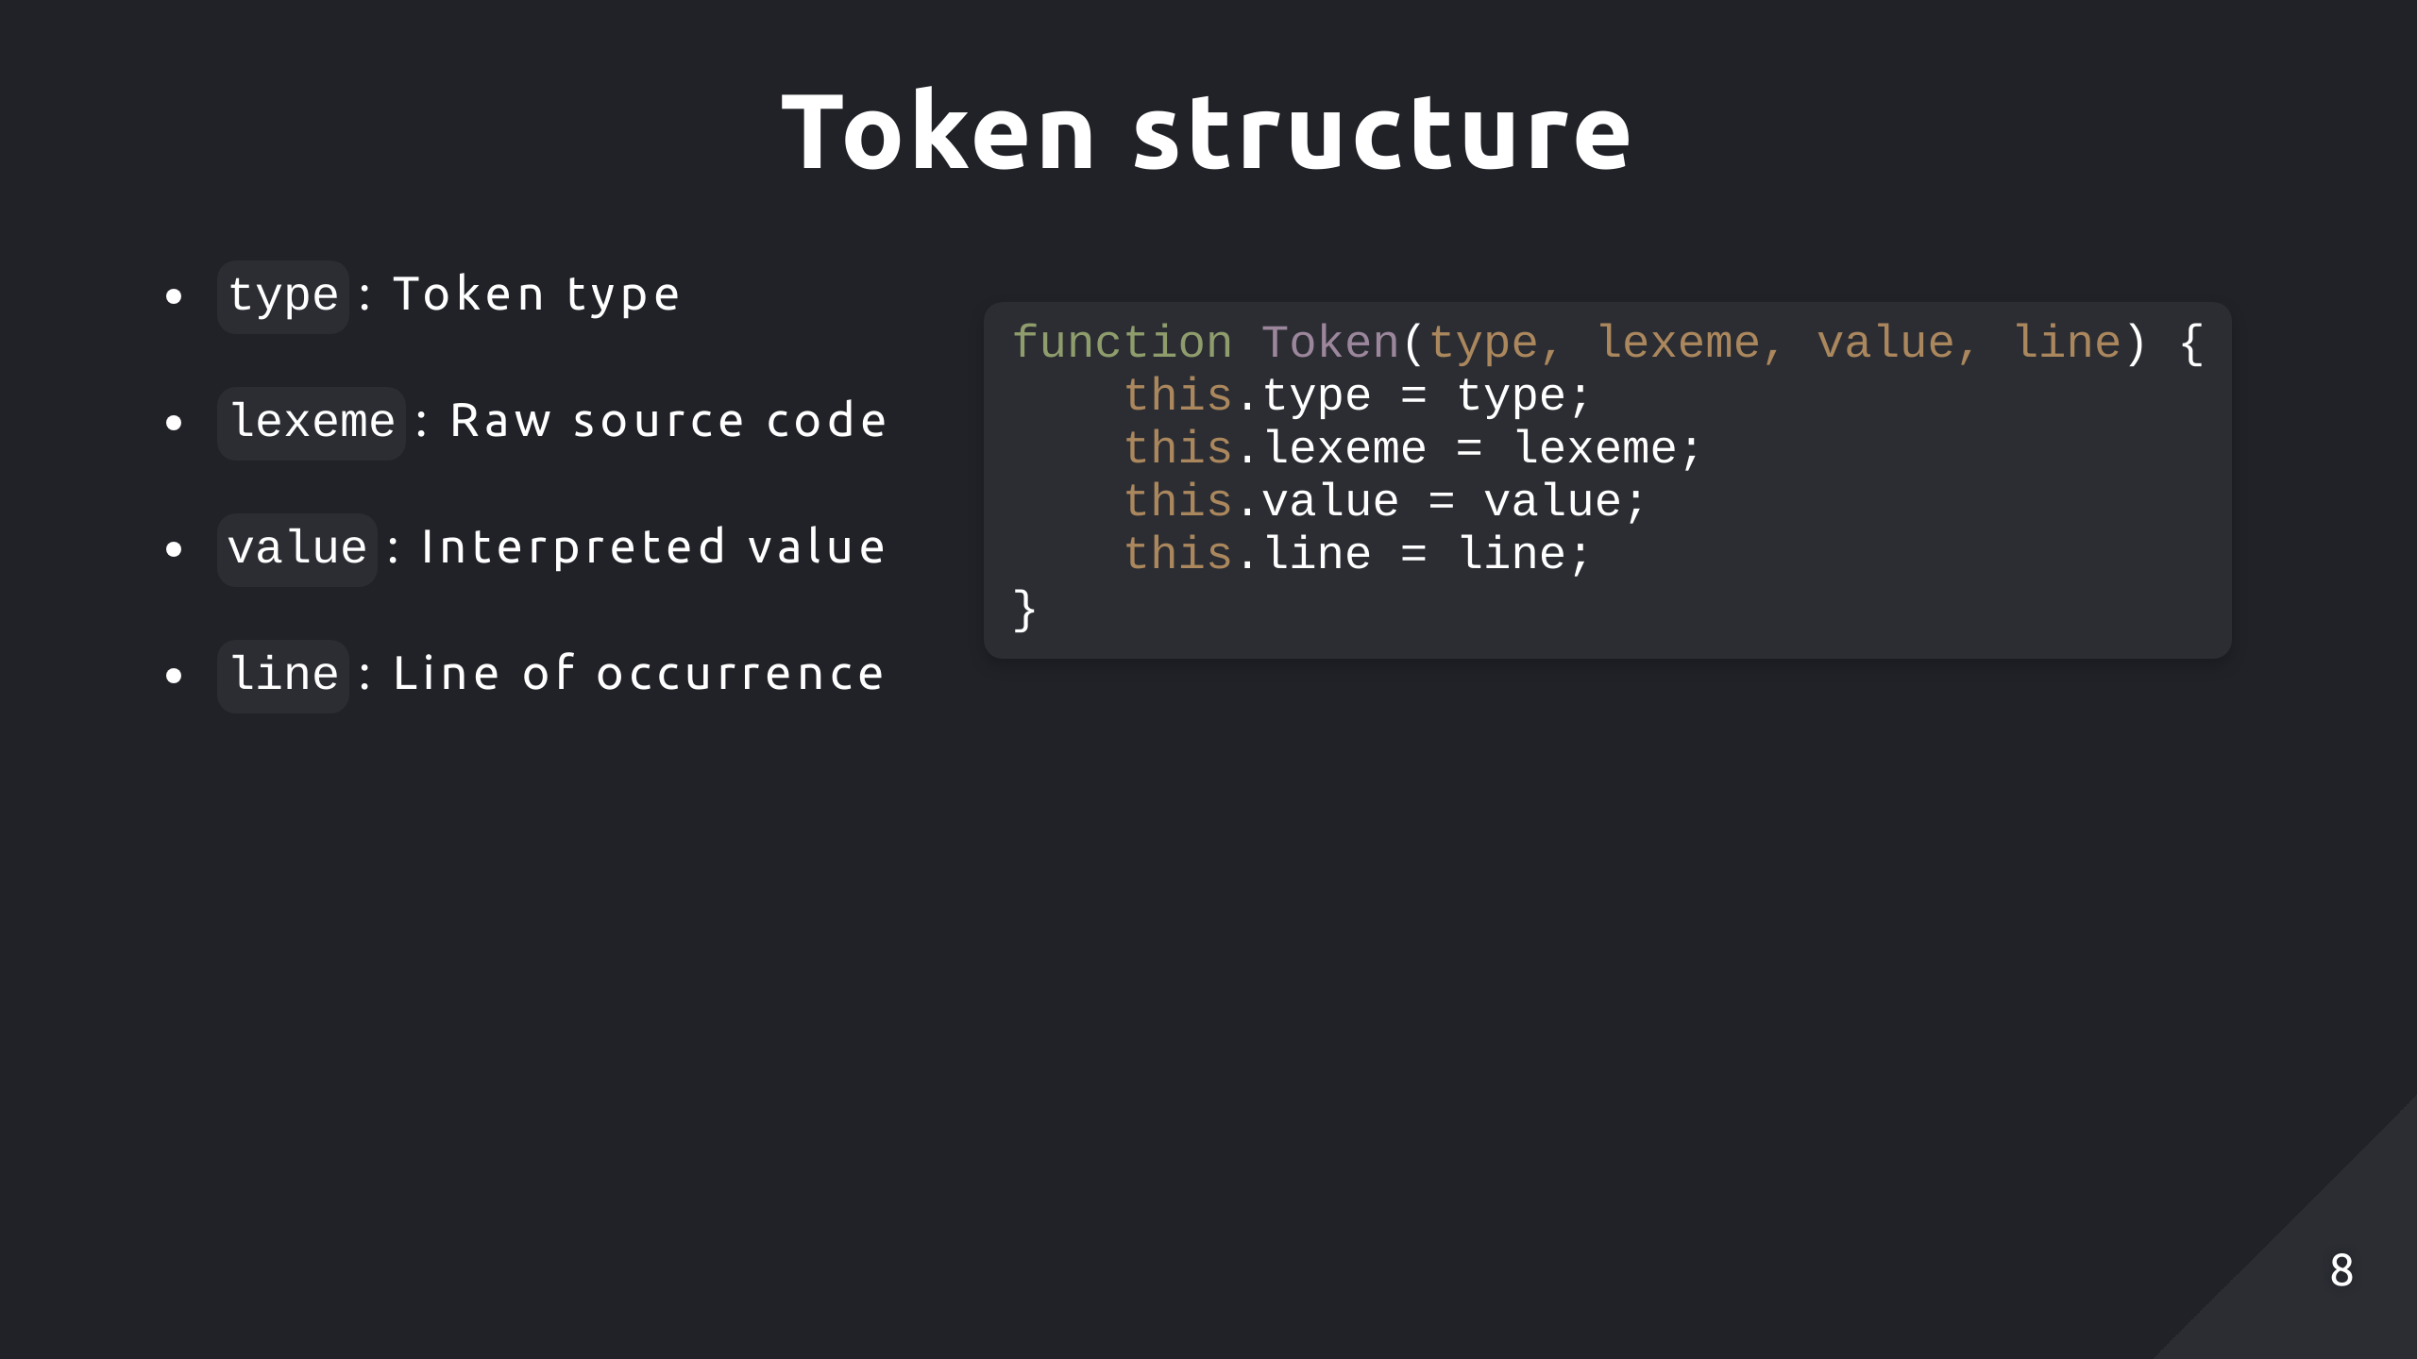
Notes:
Value is null unless the token represents a literal value like strings or numbers which can be used for semantic analysis or evaluation

Slide 9
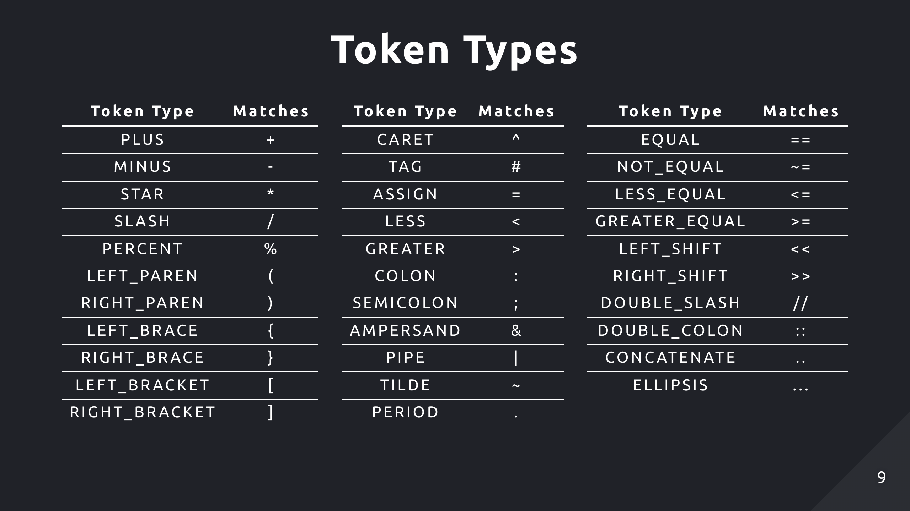

Slide 10
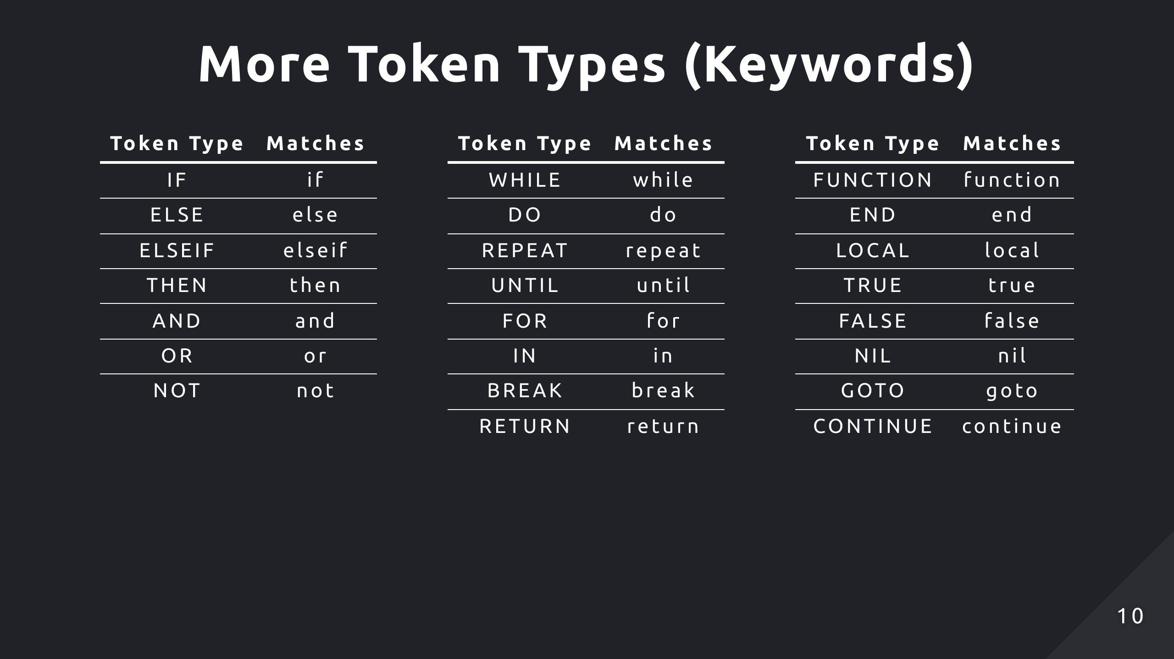

Slide 11
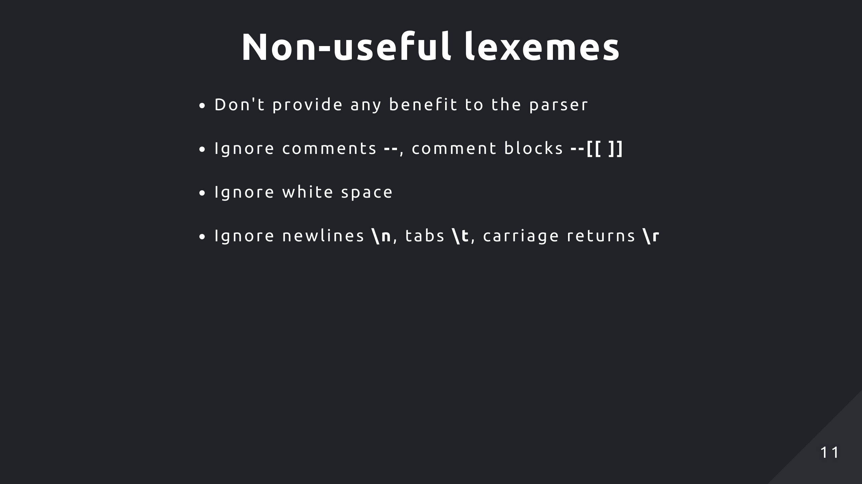

Slide 12
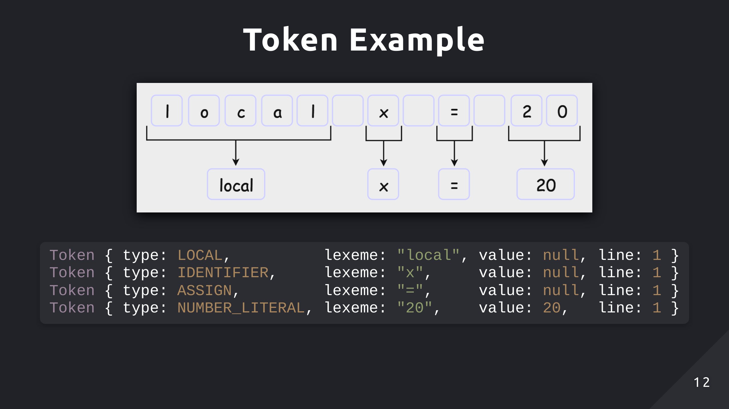

Slide 13
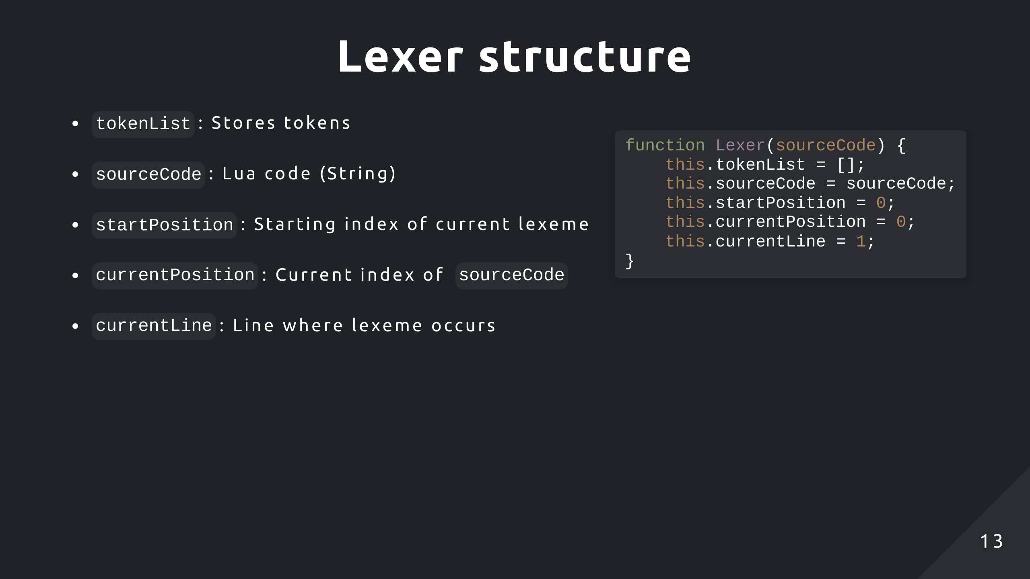
Notes:
currentPosition will iterate over source code
startPosition is updated to the starting index of a new lexeme

Slide 14
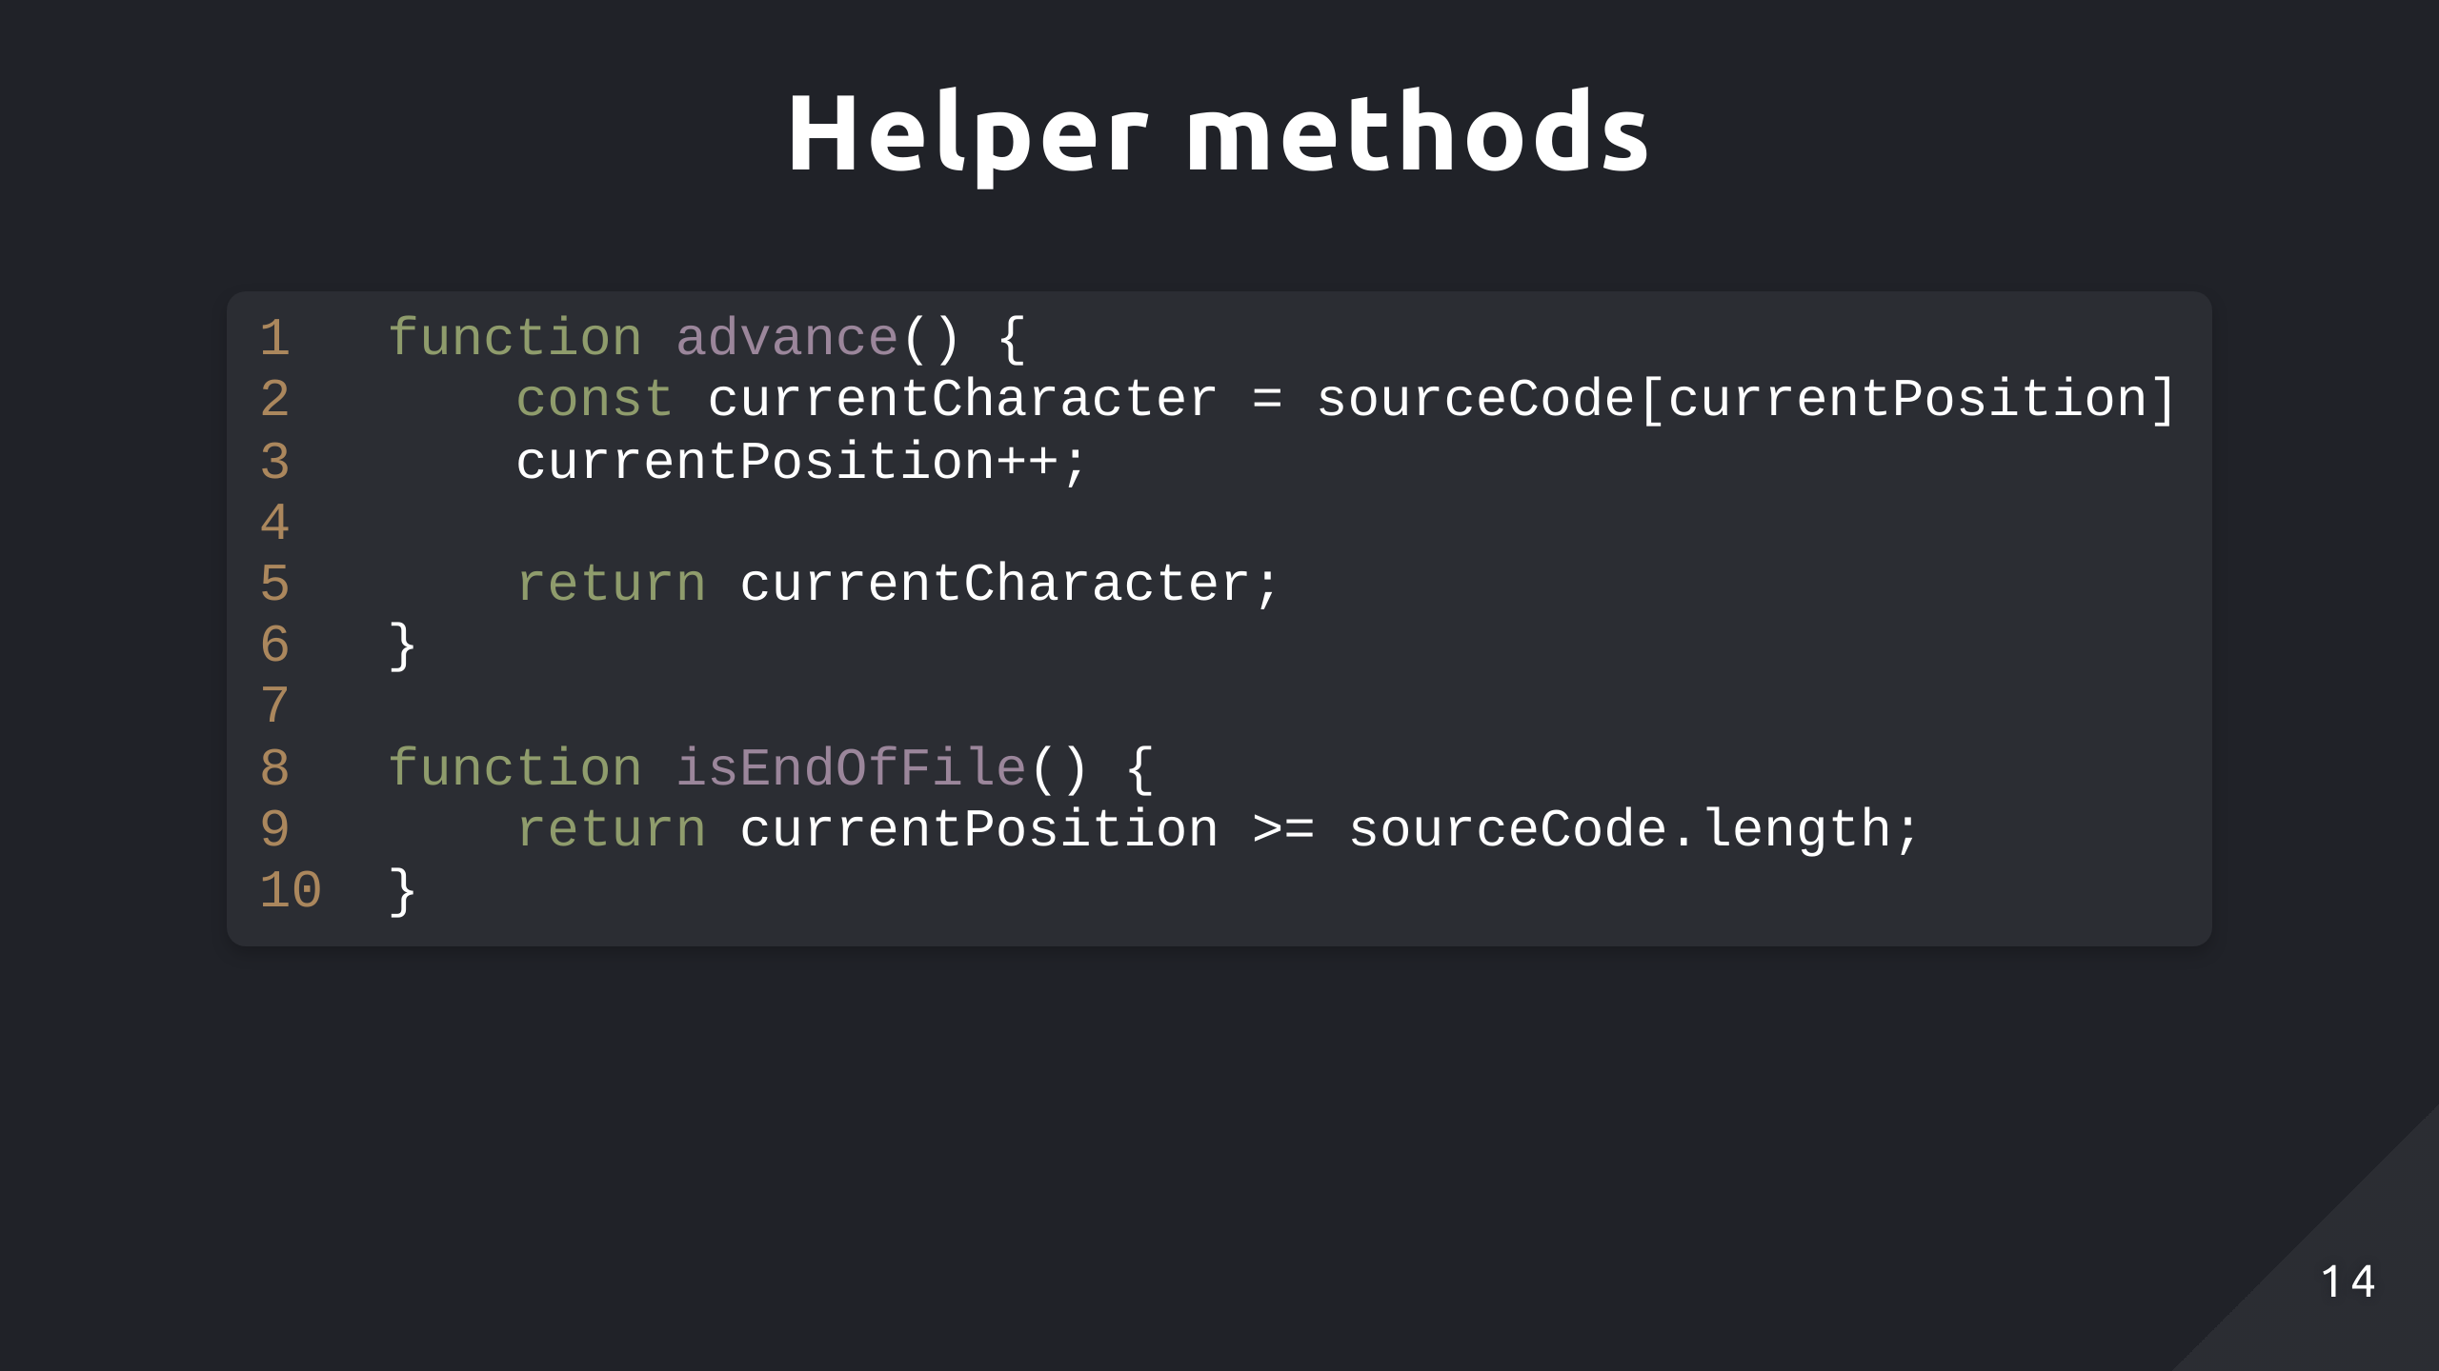

Slide 15
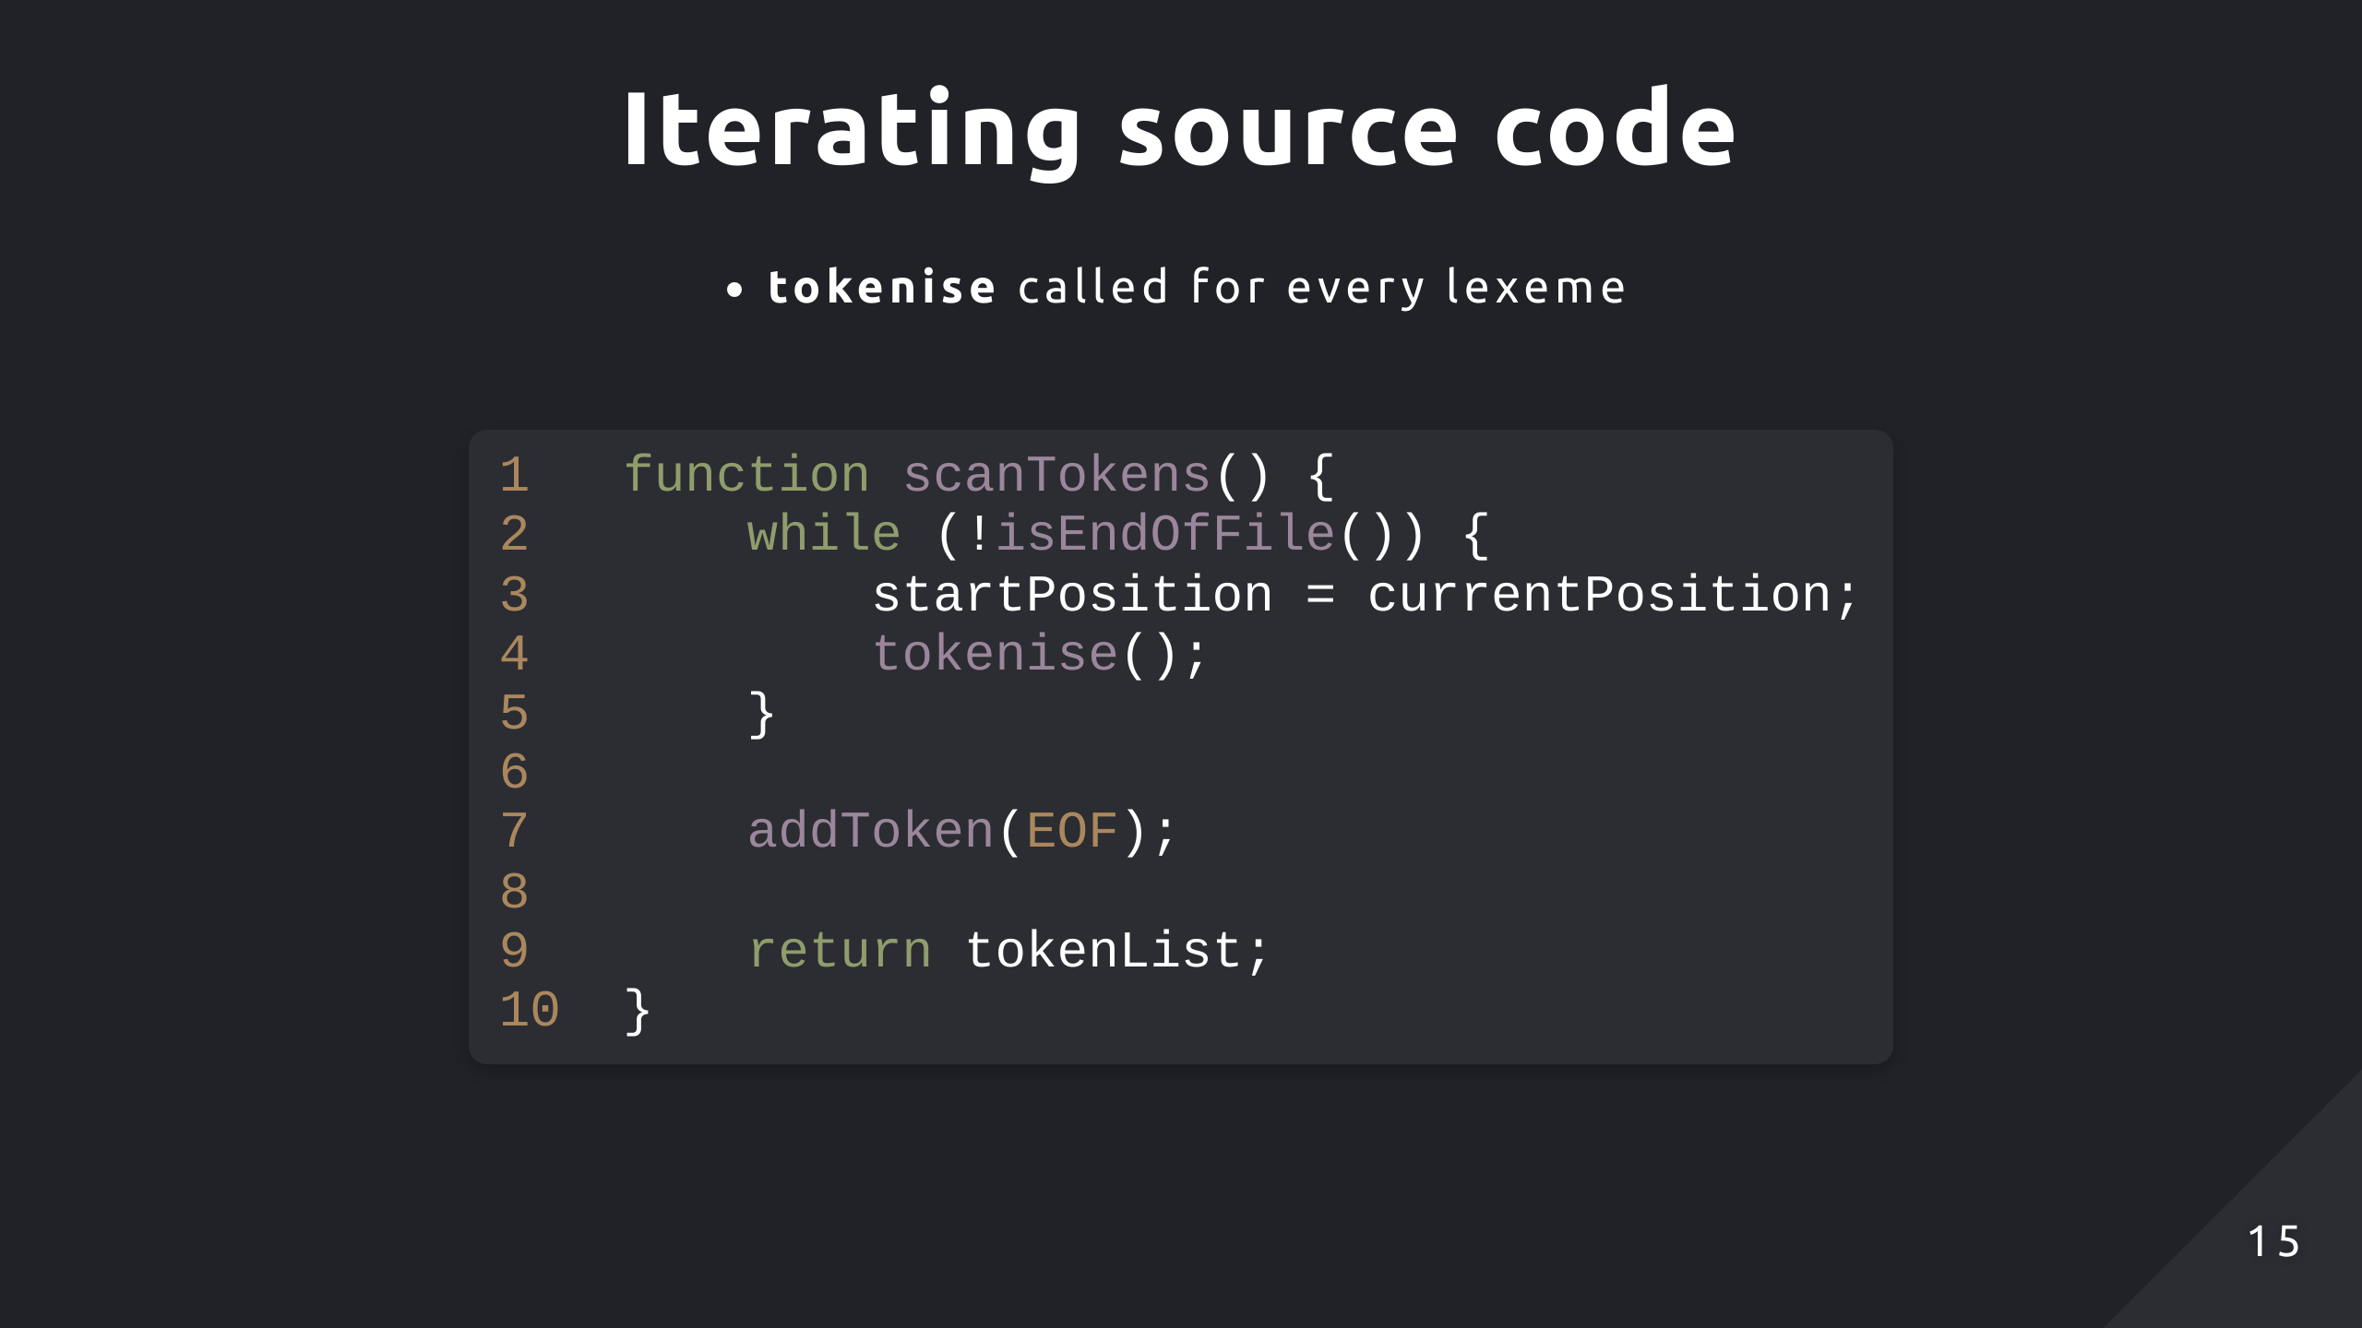
Notes:
Top level function
EOF token serves as a clear indicator of the input stream for the parsing stage

Slide 16
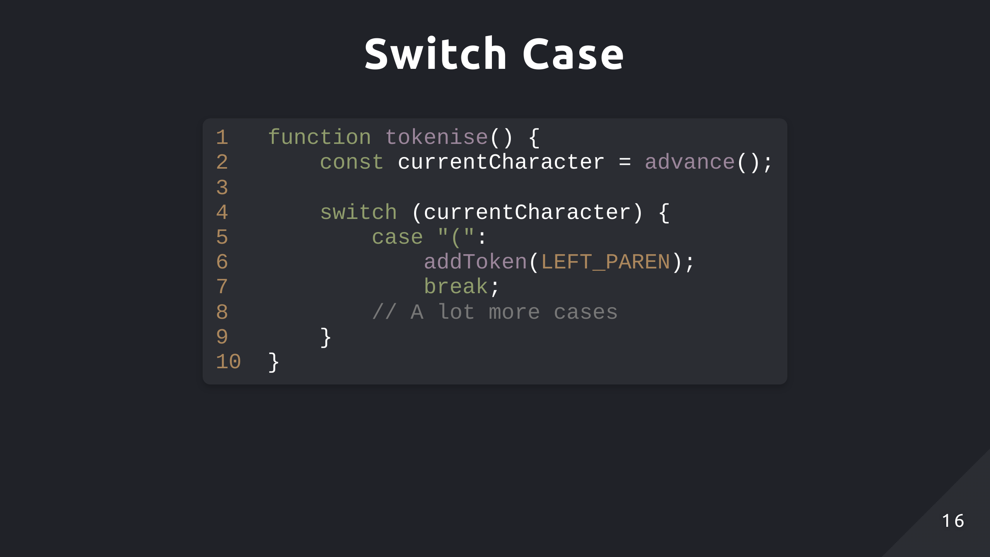

Slide 17
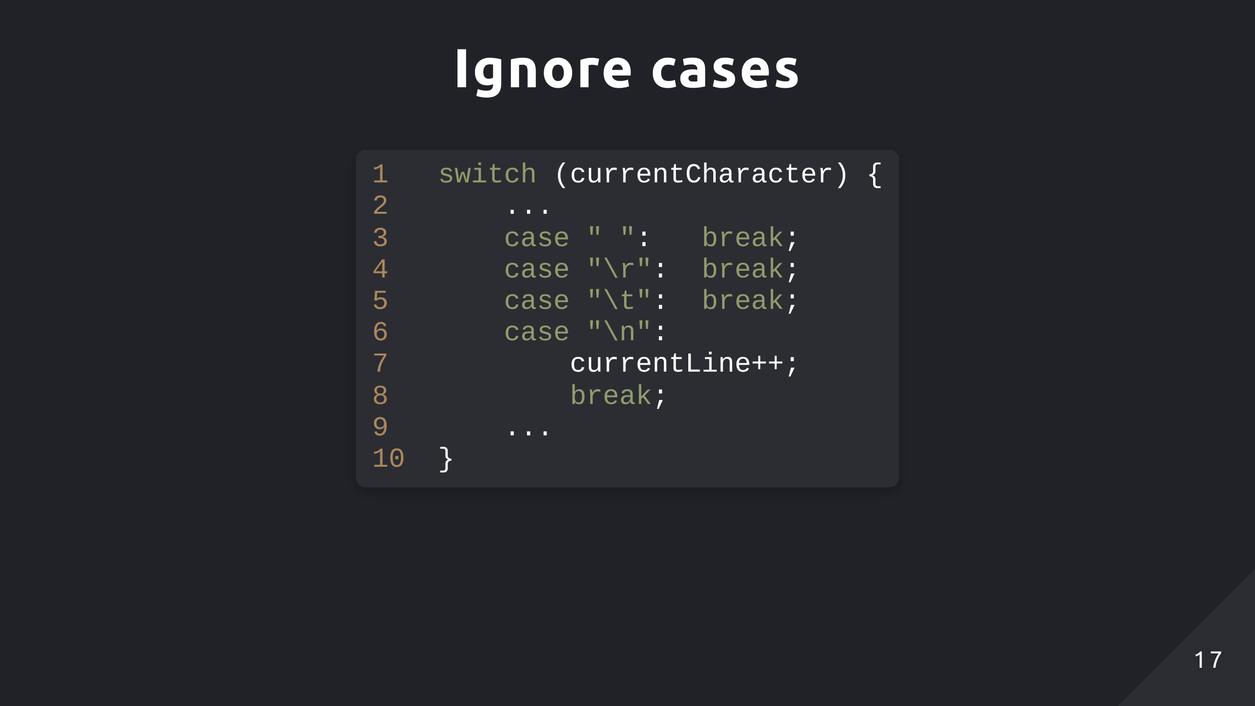

Slide 18
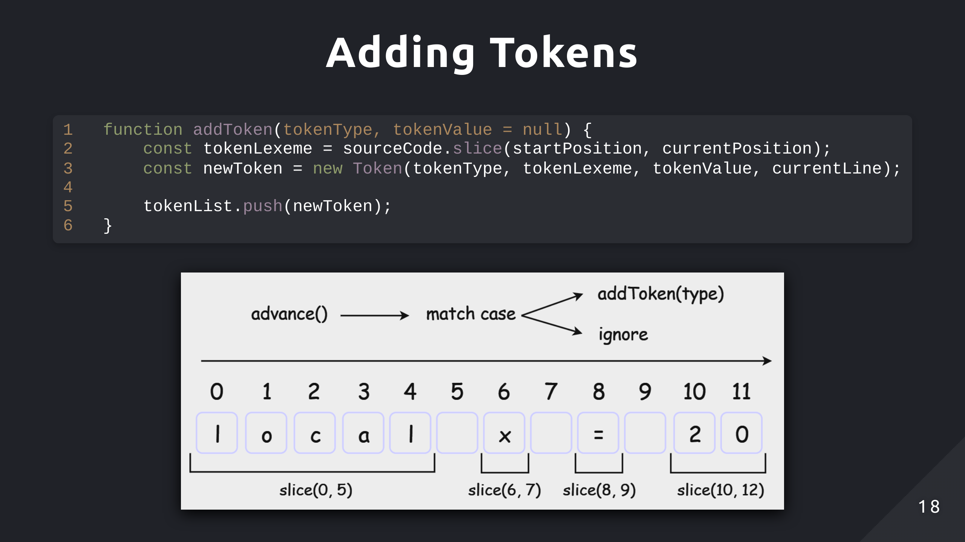

Slide 19
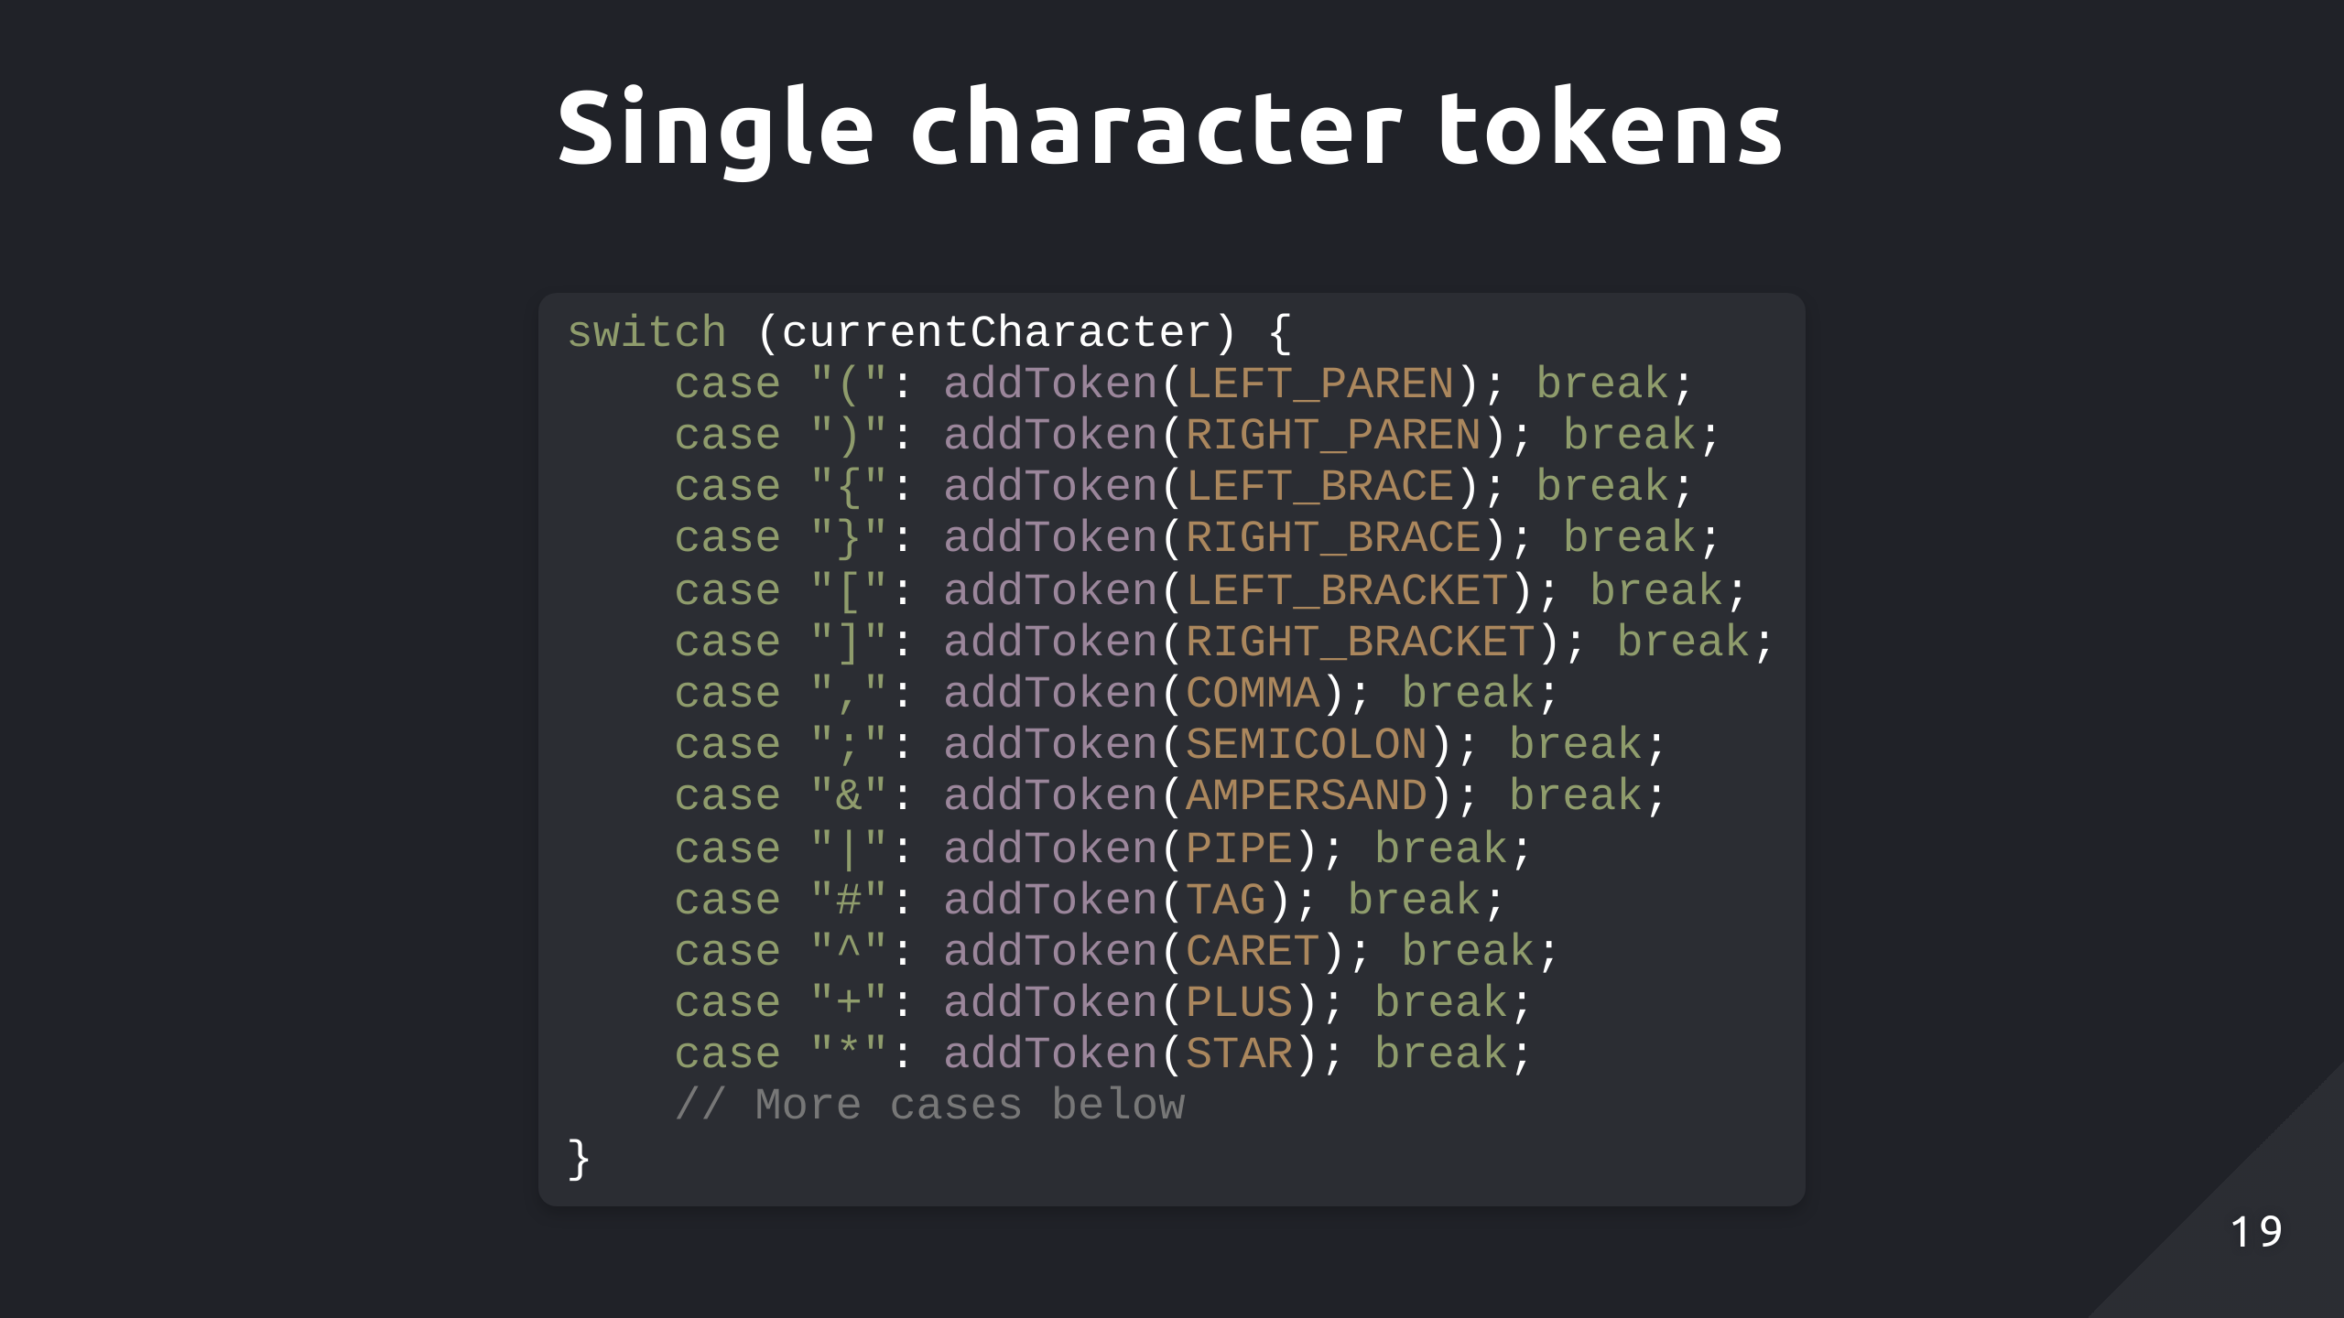

Slide 20
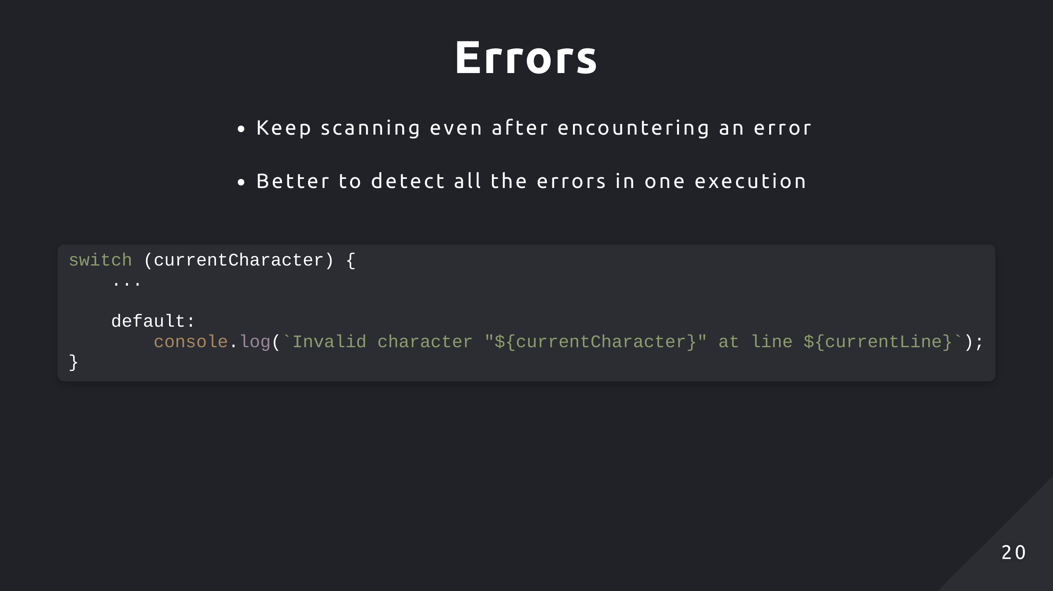

Slide 21
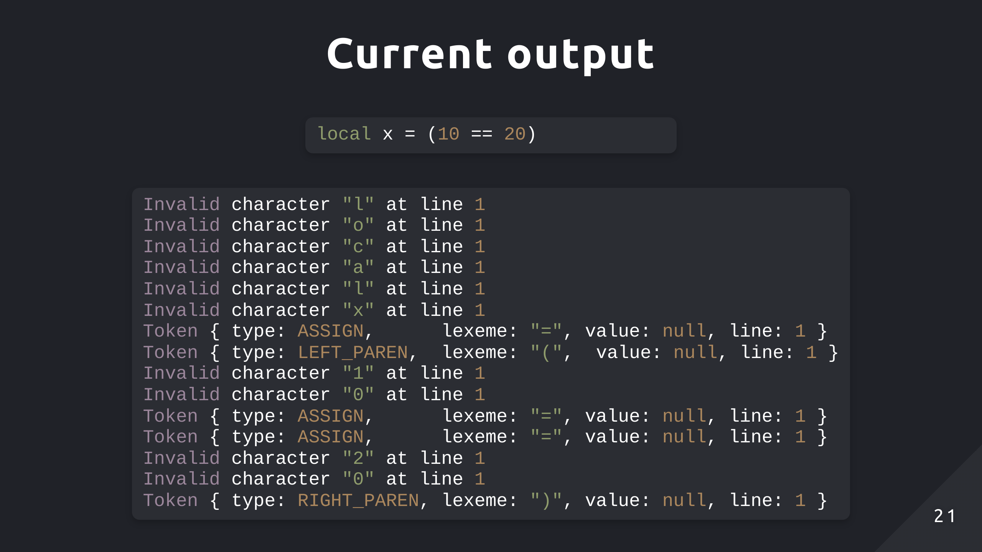

Slide 22
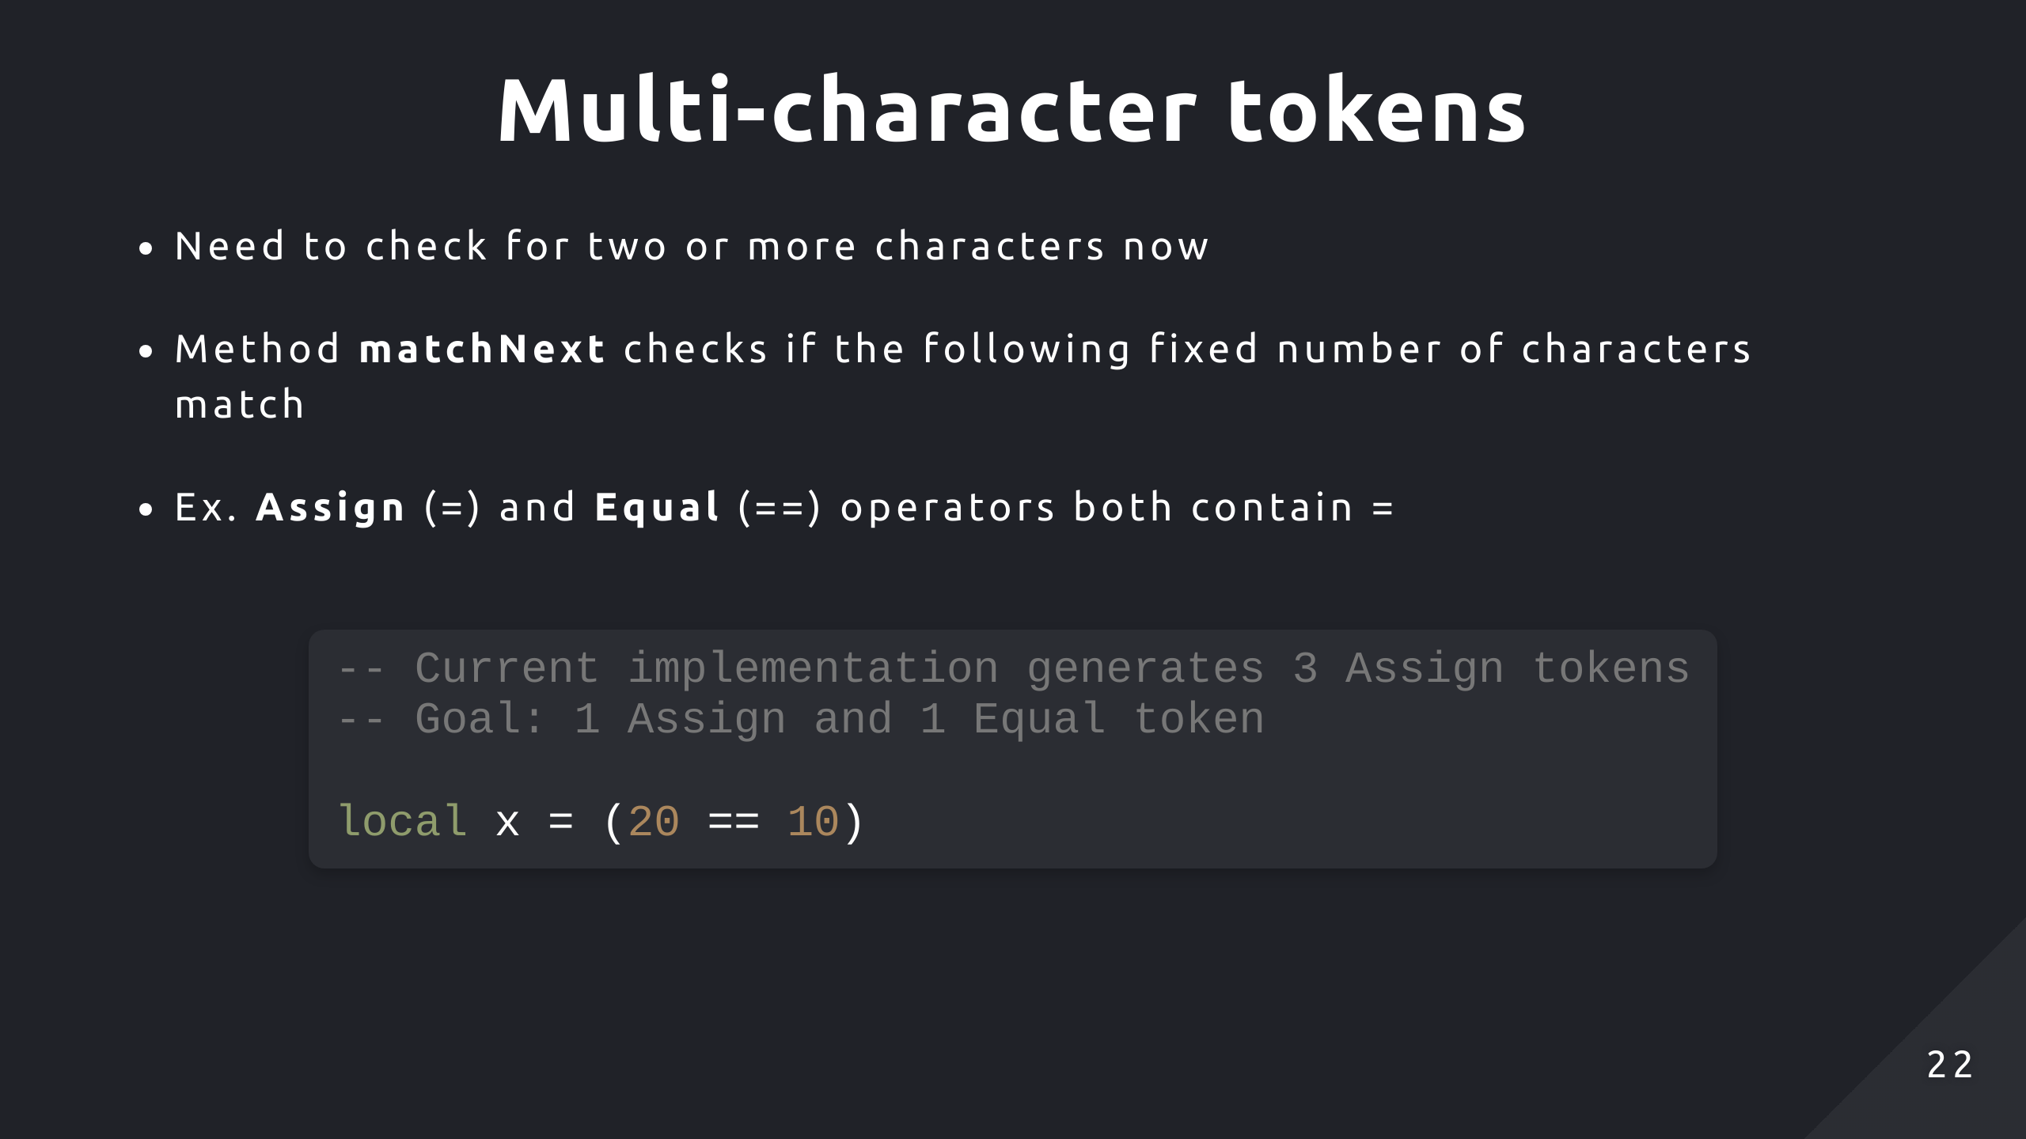

Slide 23
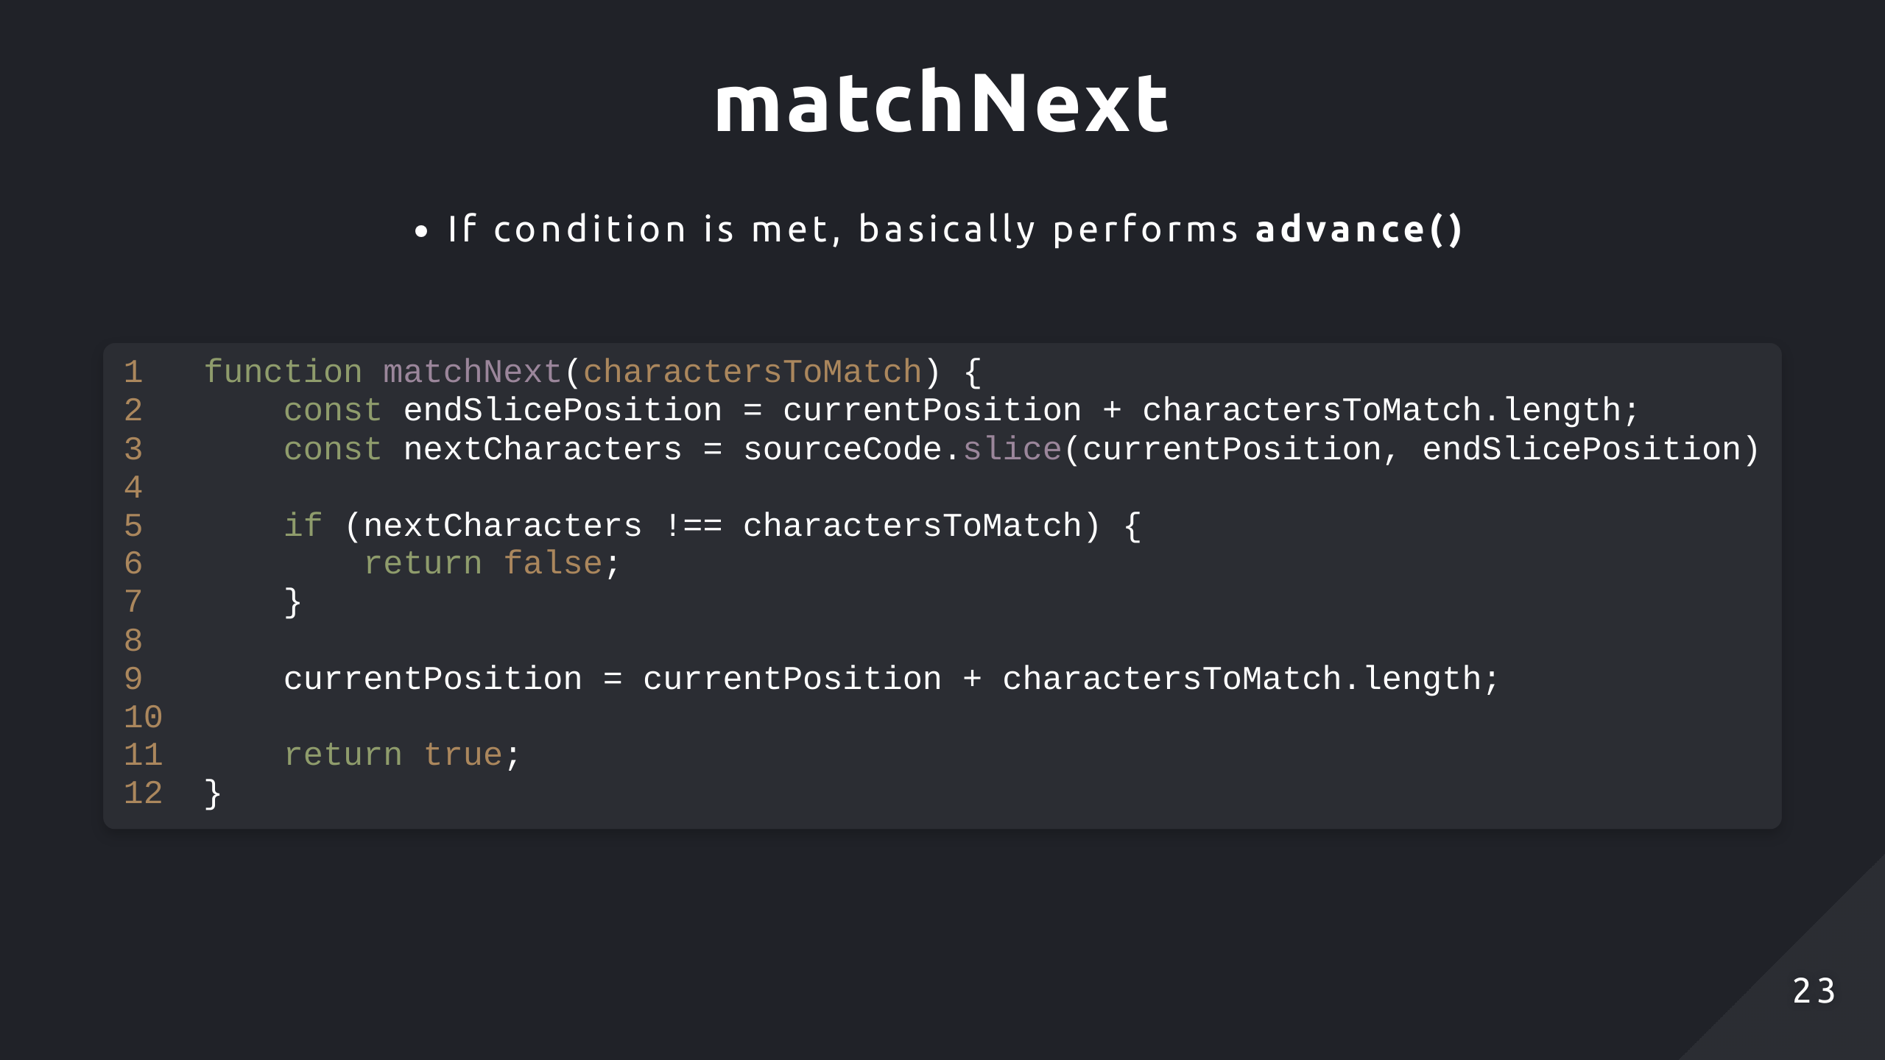

Slide 24
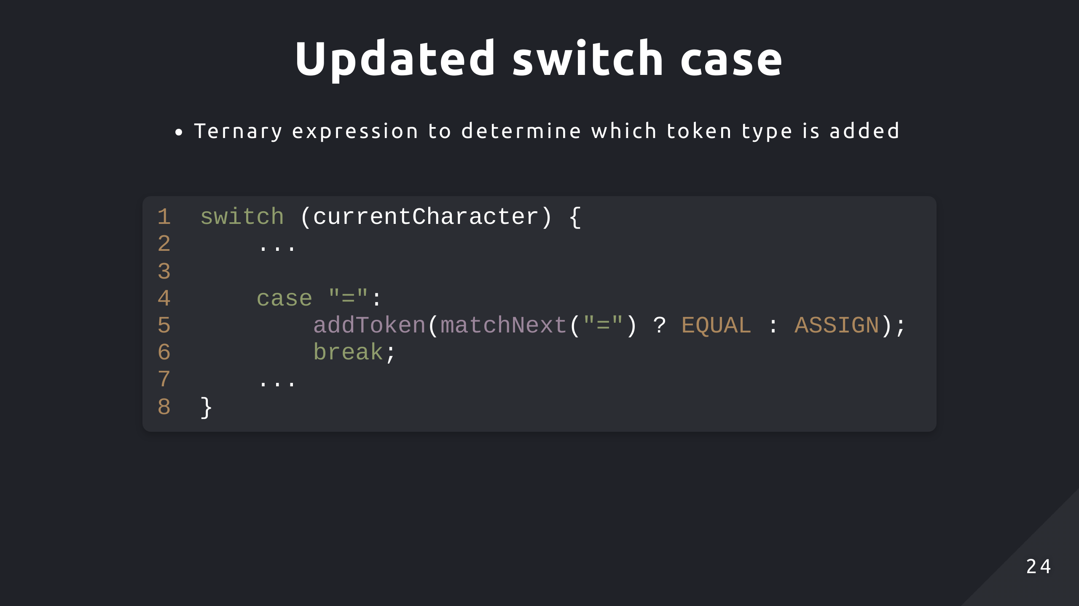

Slide 25
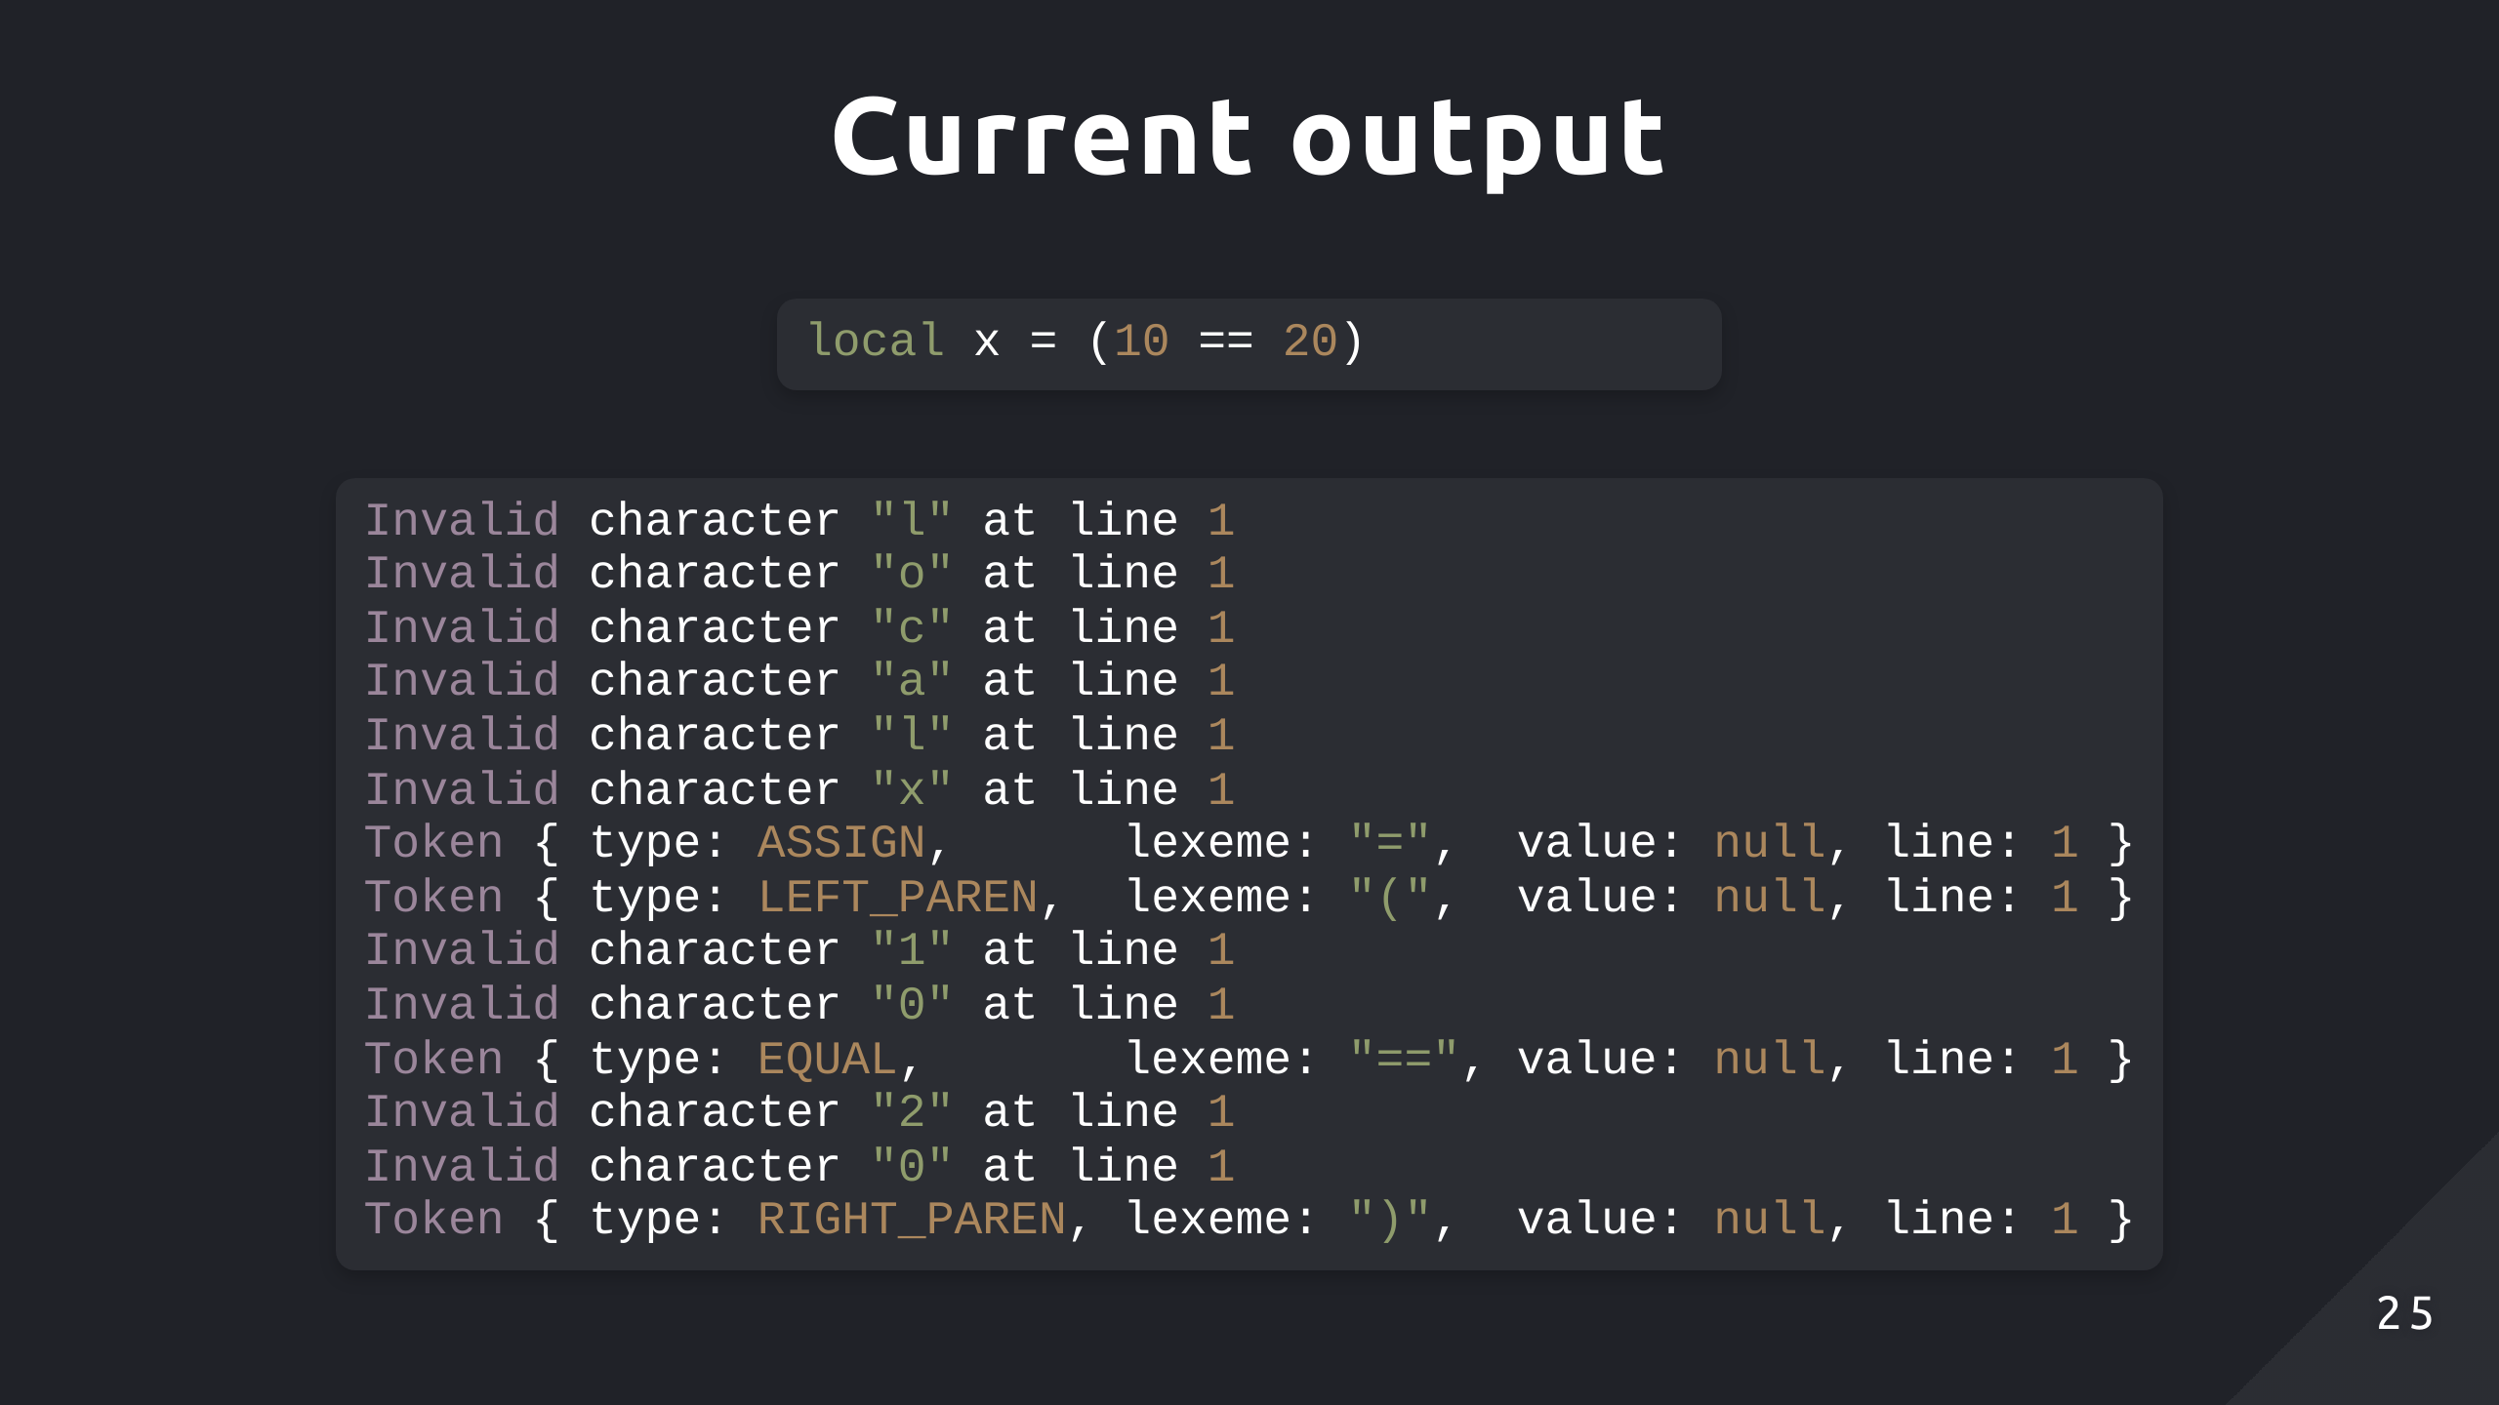

Slide 26
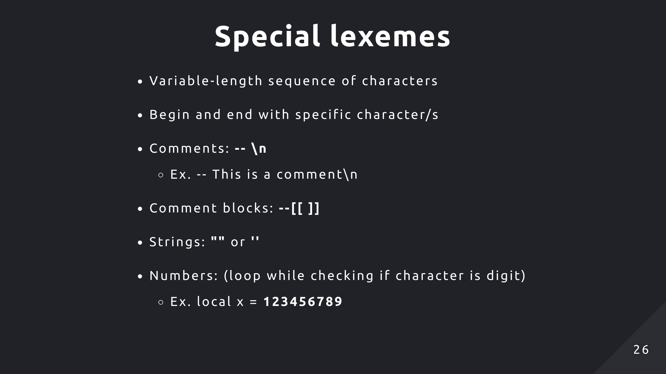

Slide 27
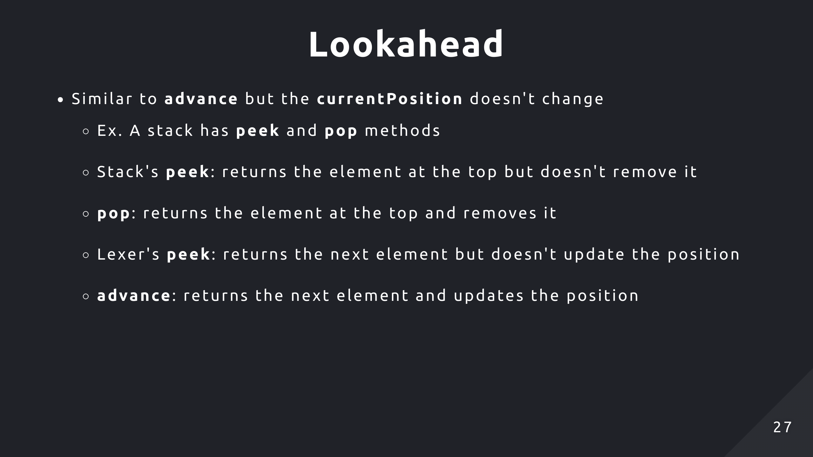

Slide 28
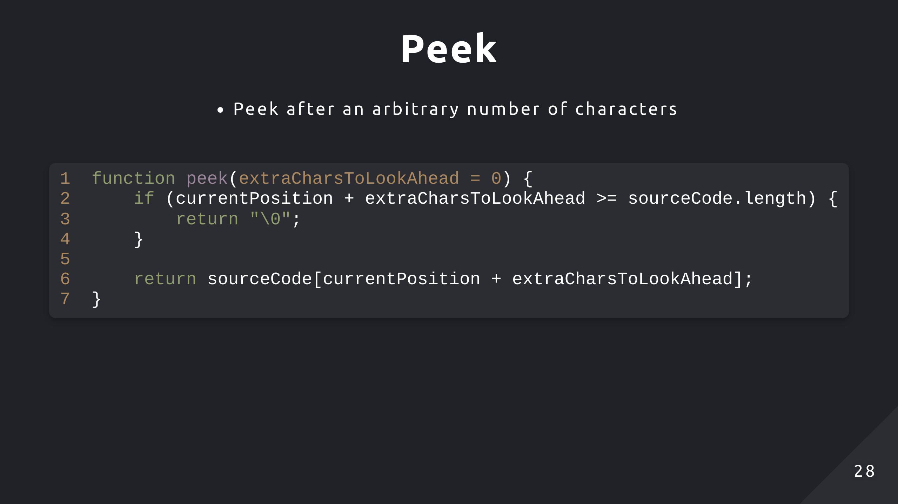

Slide 29
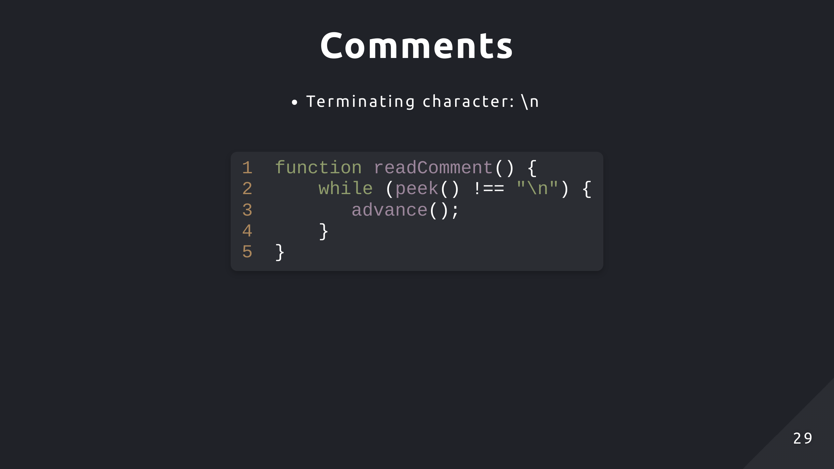

Slide 30
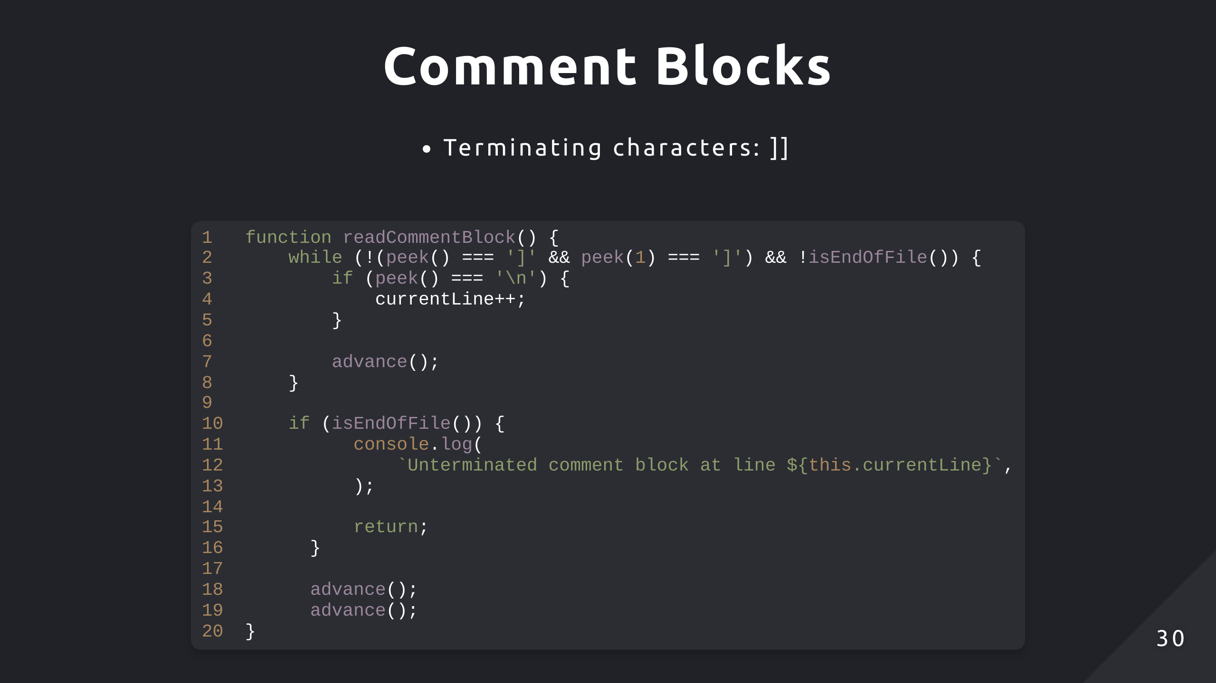

Slide 31
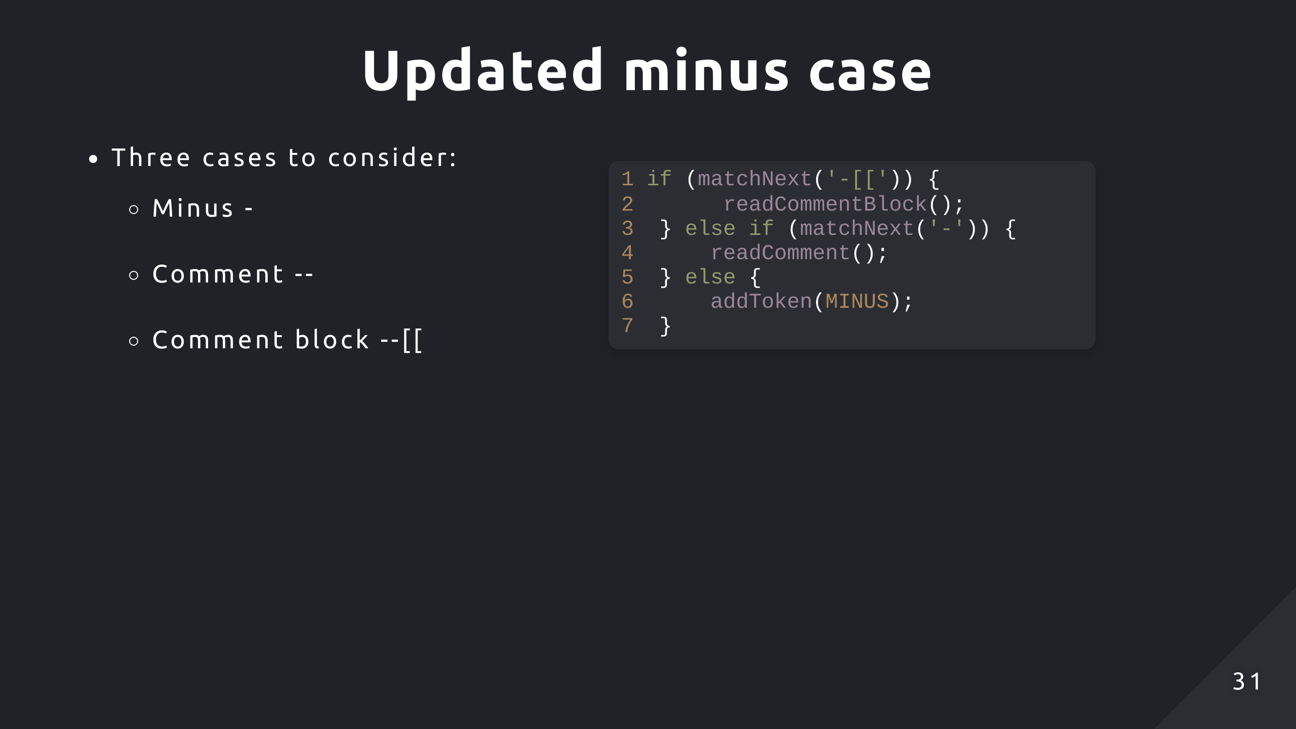

Slide 32
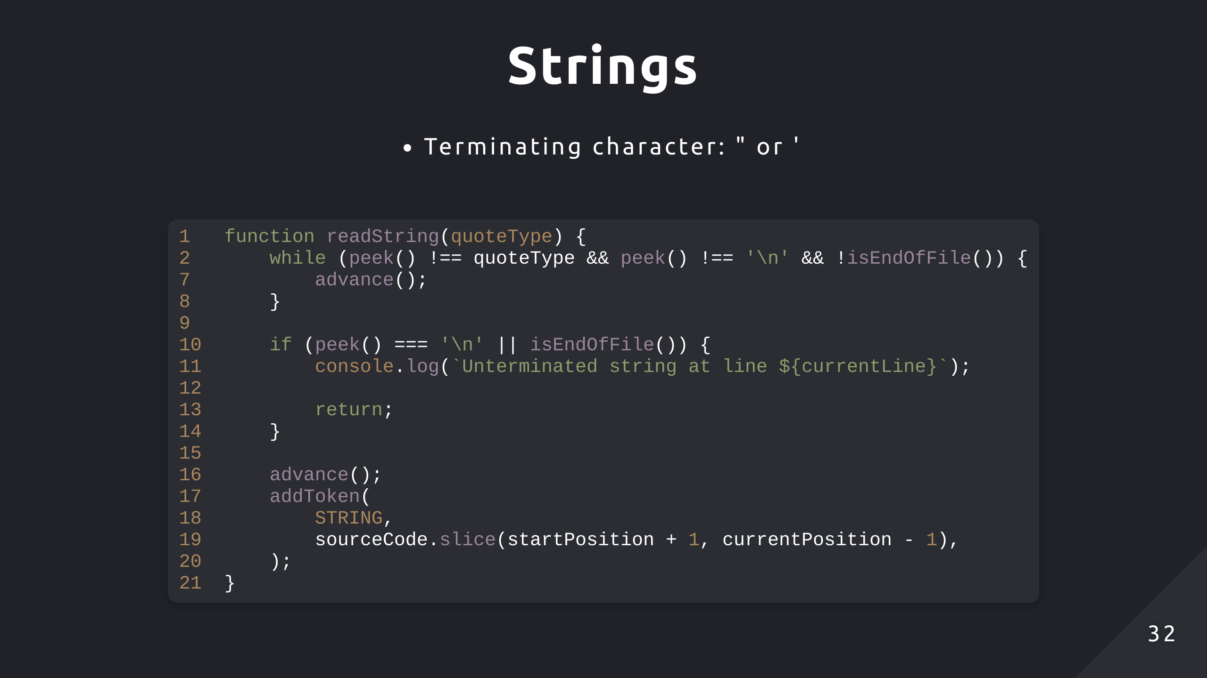

Slide 33
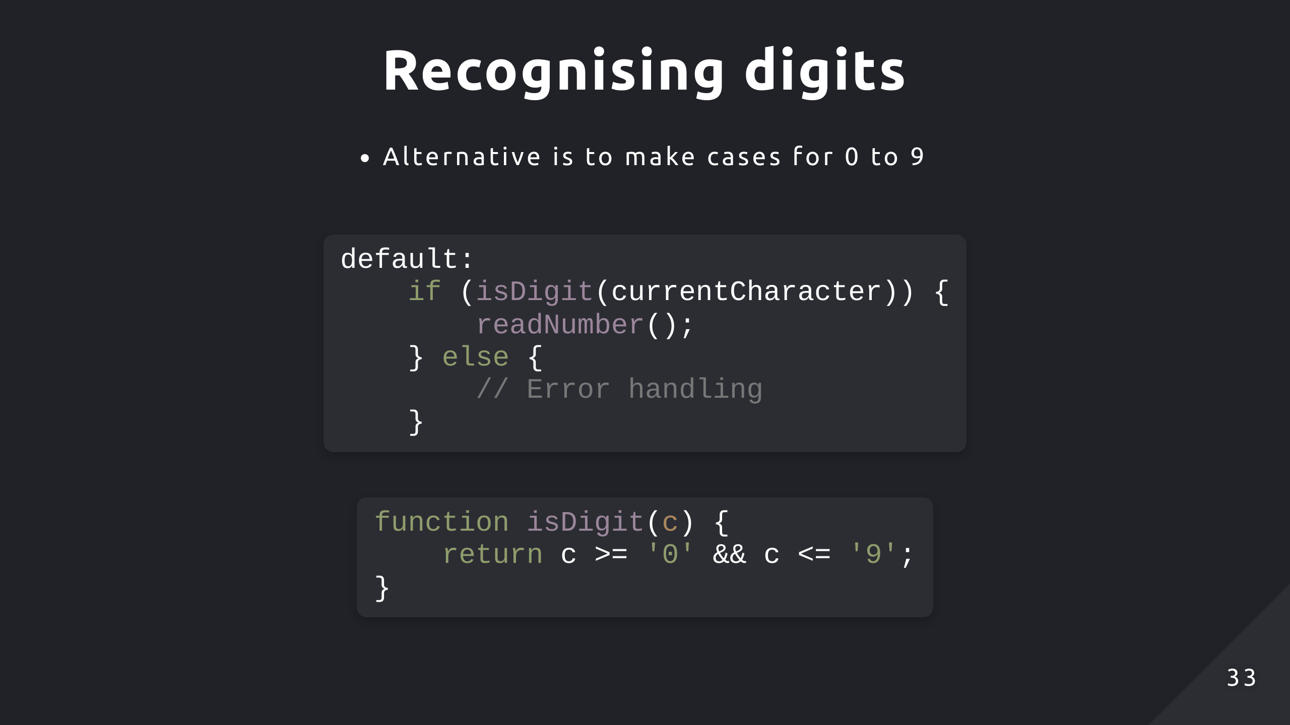
Notes:
return /^\d$/.test(character);

Slide 34
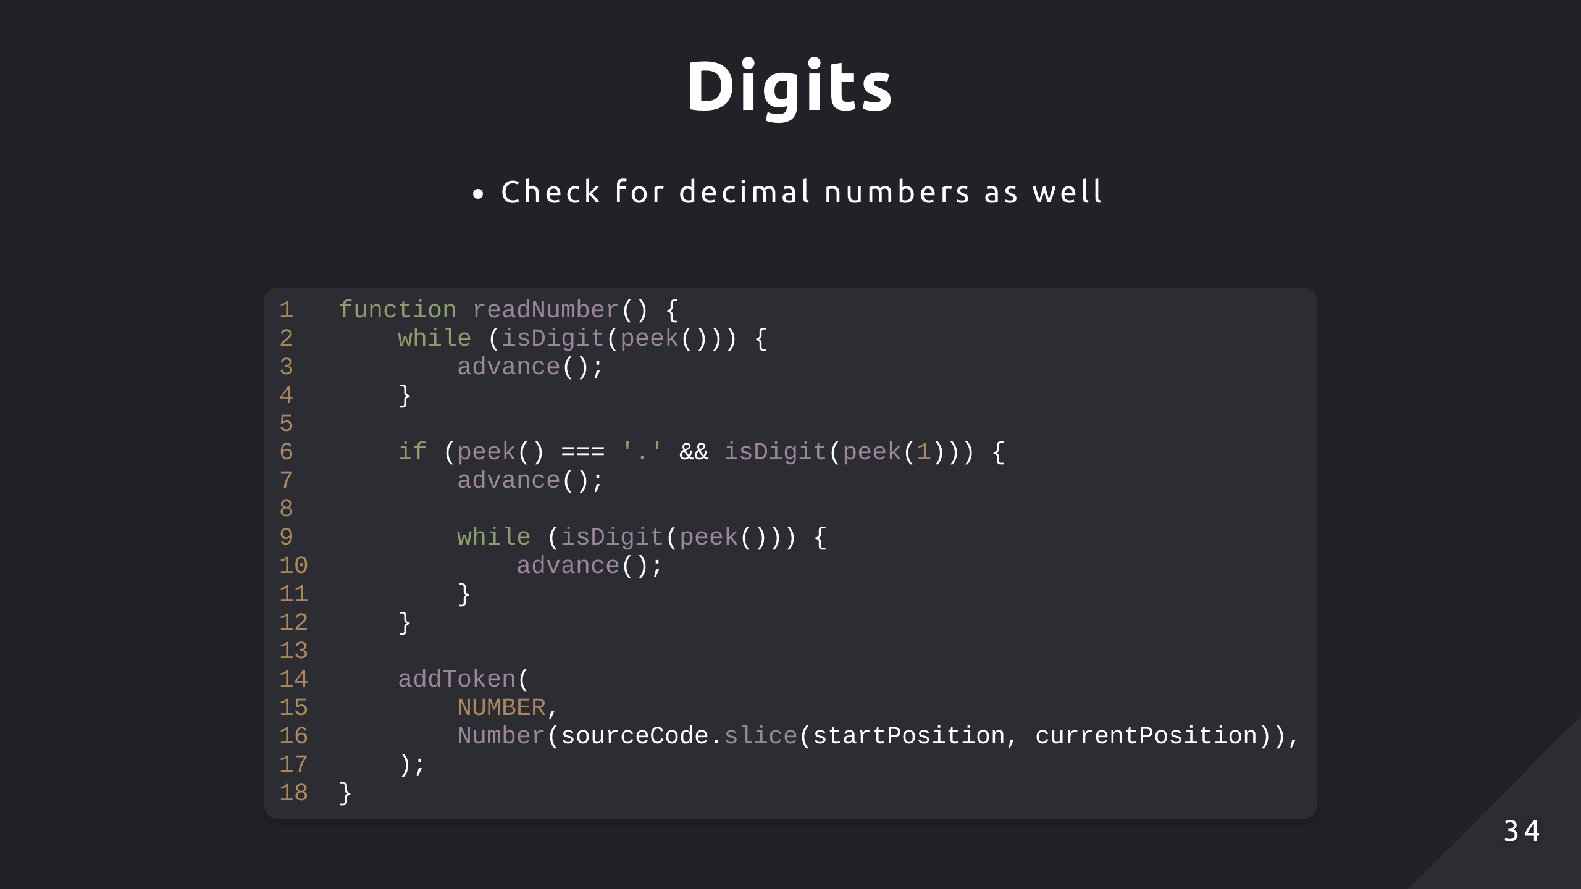

Slide 35
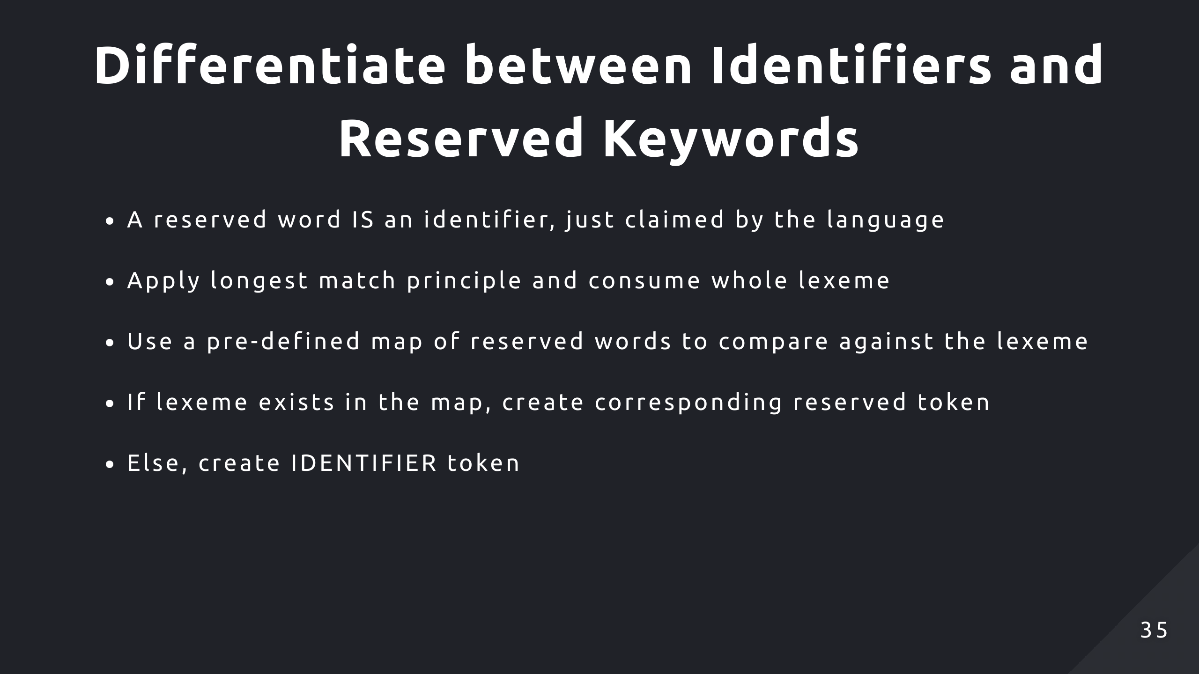
Notes:
Principle: When multiple patterns can match a sequence, it chooses the longest match
Ex. function, functionX

Slide 36
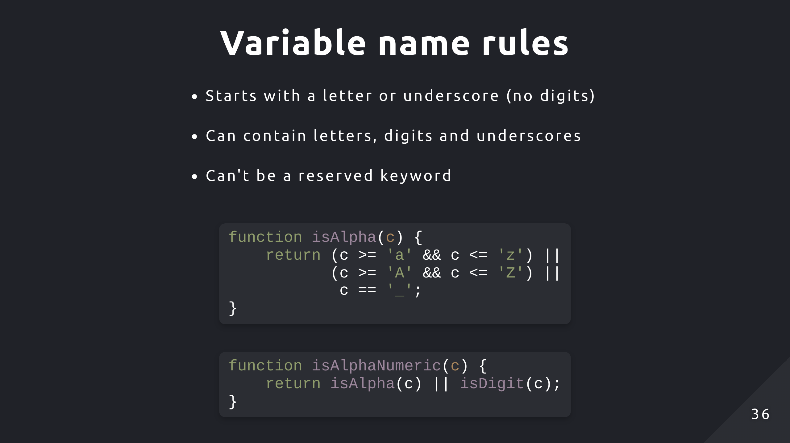
Notes:
return /^[a-zA-Z_]$/.test(character);

Slide 37
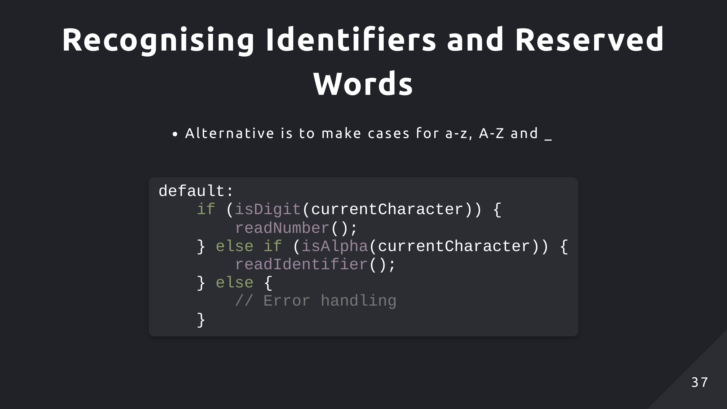

Slide 38
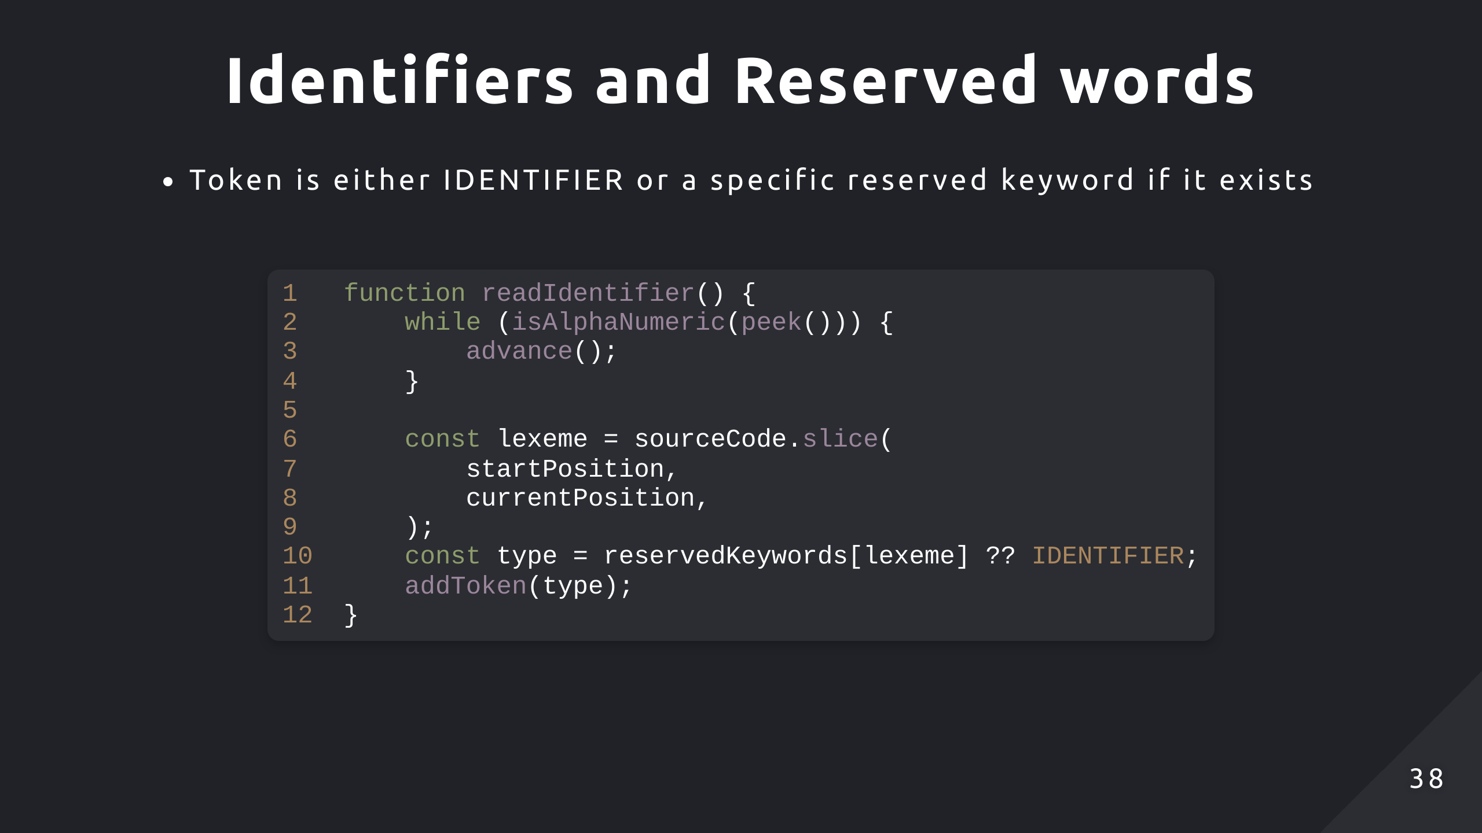

Slide 39
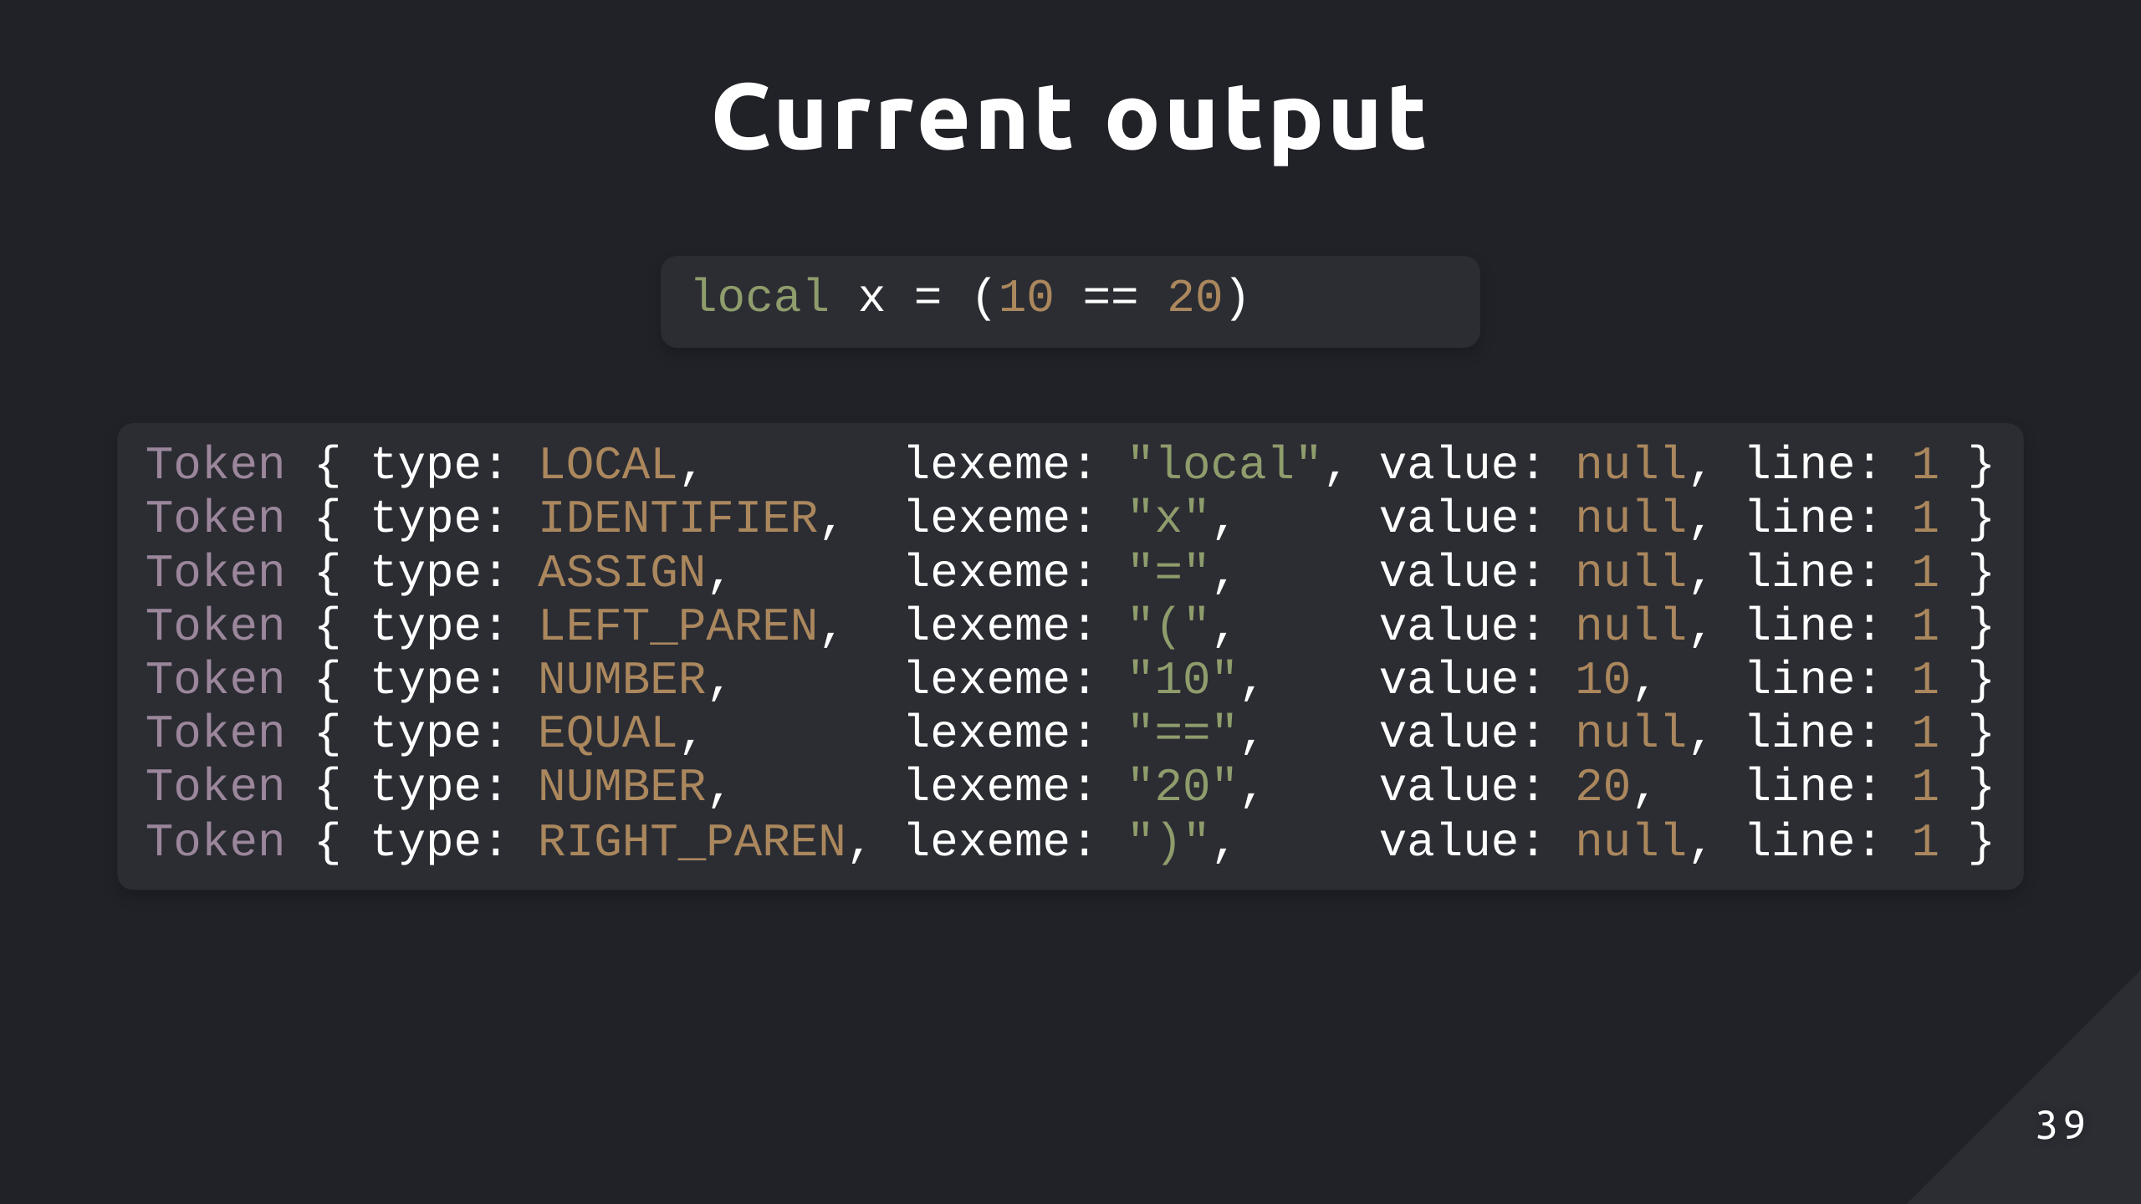

Slide 40
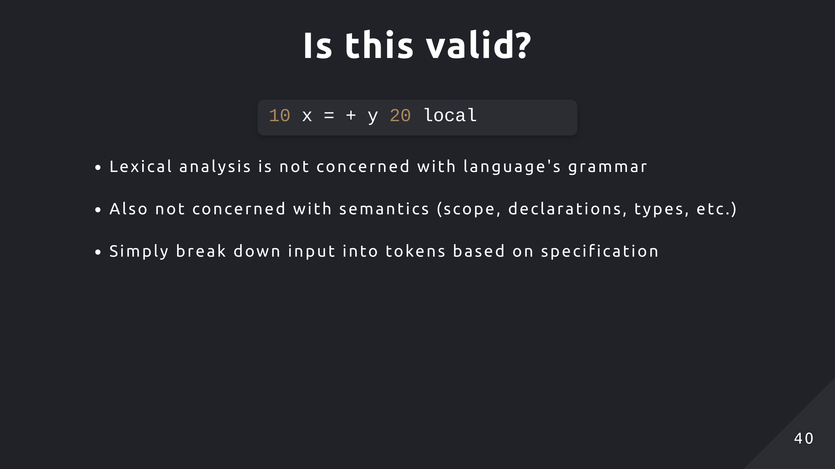

Slide 41
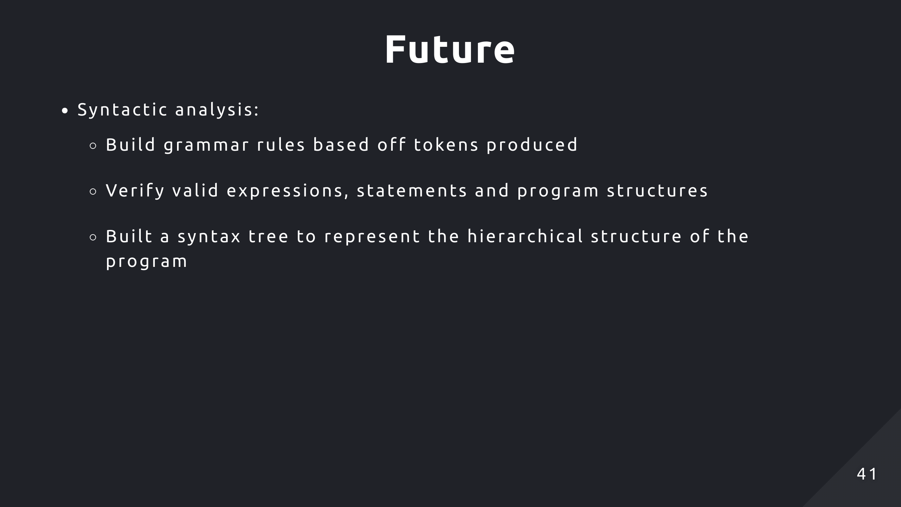

Slide 42
